Slide 1
NONPARAMETRIC STATISTICS FOR BEHAVIORAL SCIENCE
Prof. Mihaela Paun

Slide 2
REVIEW
Statistics is a field within mathematics that involves the summary and analysis of data. The field of statistics can be divided into two general areas, descriptive statistics and inferential statistics.
Descriptive statistics is a branch of statistics in which data are only used for descriptive purposes and are not employed to make predictions. Thus, descriptive statistics consists of methods and procedures for presenting and summarizing data. The procedures most commonly employed in descriptive statistics are the use of tables and graphs, and the computation of measures of central tendency and variability.
Inferential statistics employs data in order to draw inferences (i.e., derive conclusions) or make predictions. Typically, in inferential statistics sample data are employed to draw inferences about one or more populations from which the samples have been derived. Whereas a population consists of the sum total of subjects or objects that share something in common with one another, a sample is a set of subjects or objects which have been derived from a population.

Slide 3
REVIEW
A statistic refers to a characteristic of a sample, such as the average score (also known as the mean).
A parameter, on the other hand, refers to a characteristic of a population (such as the average of a whole population).
The most basic statistics that are employed for both descriptive and inferential purposes are measures of central tendency (of which the mean is an example) and measures of variability.

Slide 4
REVIEW - MEASUREMENT SCALES
Nominal data (also called categorical data), are represented by counting the number of times a particular event or condition occurs.
For example, you may categorize the political alignment of a group of voters. Group members could be labeled democratic, republican, independent, undecided, or other. No single person should fall into more than one category.
In nominal/categorical measurement, numbers are employed merely to identify mutually exclusive categories, but cannot be manipulated in a meaningful mathematical manner.
As an example, a person's social security number represents nominal measurement, since it is used purely for purposes of identification, and cannot be meaningfully manipulated in a mathematical sense.

Slide 5
REVIEW - MEASUREMENT SCALES
Ordinal data (also know as rank-order data), data describe values that occur in some order or rank.
However, distance between any two ordinal values holds no particular meaning.
For example, imagine lining up a group of people according to height. It would be very unlikely that the individual heights would increase evenly.
Another example of an ordinal scale is a Likert-type scale. This scale asks the respondent to make a judgment using a scale with three, five, or seven items. The range of such a scale might use a 1 to represent strongly disagree, while a 5 might represent strongly agree. This type of scale can be considered an ordinal measurement since any two respondents will vary in their interpretations of the scale values.
Refer to measurements where only the comparisons “greater”, “less”, or “equal” between measurements are relevant.
Assign the number 1 to the most preferred of three brands, number 3 to the least preferred.
It is this ability to order the elements, on the basis of the relative size of their measurements, that gives the name of the ordinal scale.

Slide 6
REVIEW - MEASUREMENT SCALES
An interval scale is a measure in which the relative distance between any two sequential values is the same.
To borrow an example from physical science, consider the Celsius scale for measuring temperature. An increase from 3 degrees to 4 degrees is identical to an increase from 55 degrees to 56 degrees.

Slide 7
REVIEW - MEASUREMENT SCALES
A ratio scale is slightly different from an interval scale. Unlike an interval scale, a ratio scale has an absolute zero value. In such a case, the zero value indicates a complete absence of a particular condition.
To borrow another example from physical science, it would be appropriate to measure light intensity with a ratio scale. Total darkness is a complete absence of light and would receive a value of zero.
Most physical measures such as weight, height, blood glucose level, as well as measures of certain behaviors such as the number of times a person coughs or the number of times a child cries, represent ratio scales.

Slide 8
Continuous versus Discrete Variables
When measures are obtained on people or objects, in most instances we assume that there will be variability.
Since we assume variability, if we are quantifying whatever it is that is being measured, not everyone or everything will produce the same score.
For this reason, when something is measured it is commonly referred to as a variable.
As noted above, variables can be categorized with respect to the level of measurement they represent. In addition, a variable can be categorized with respect to whether it is continuous or discrete.
A continuous variable can assume any value within the range of scores that define the limits of that variable.
A discrete variable, on the other hand, can assume only a limited number of values.

Slide 9
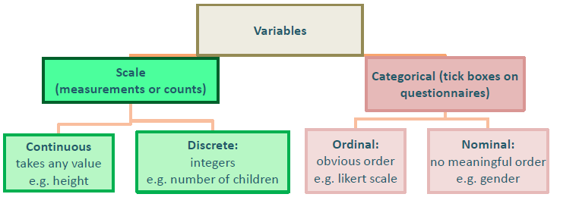
REVIEW-DATA TYPES

Slide 10
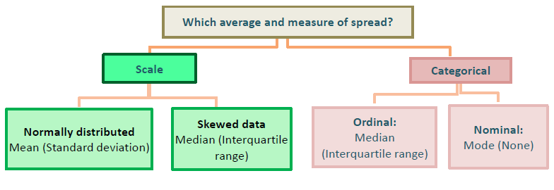
For continuous normally distributed data, summarize using
means and standard deviations. If the data is skewed or
there are influential outliers, the median (middle value)
and interquartile range (Upper quartile – lower quartile)
are more appropriate.

Slide 11
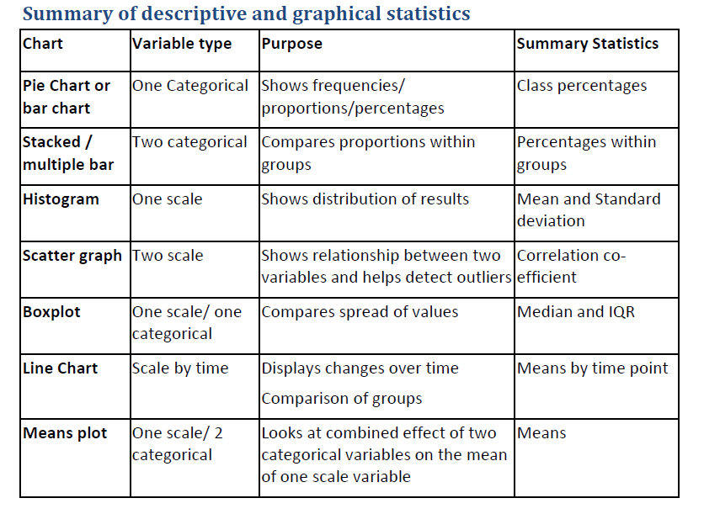
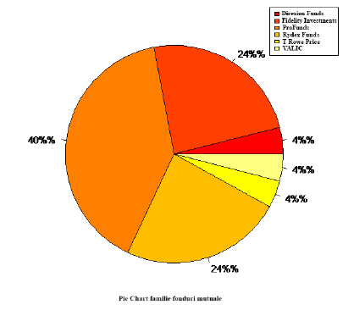
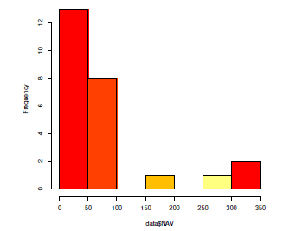
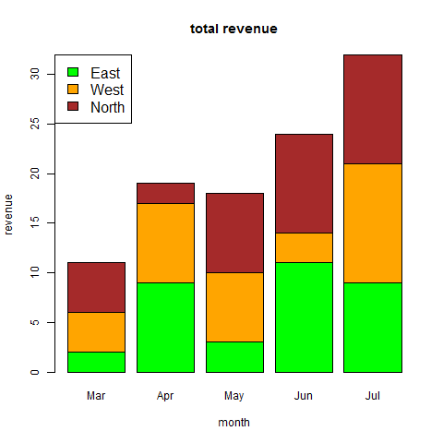
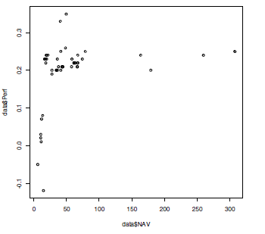
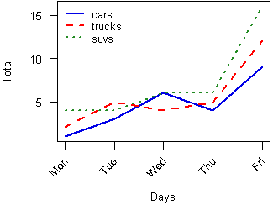
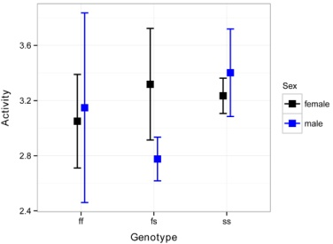
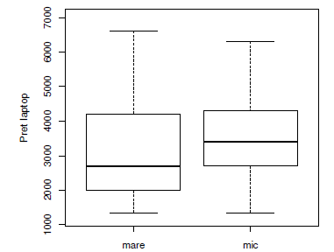

Slide 12
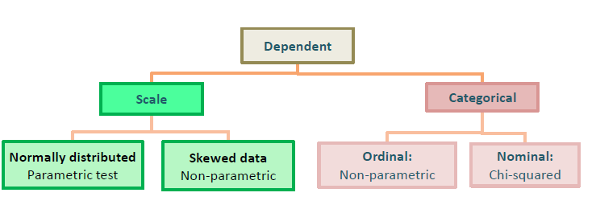
DECIDING ON APPROPRIATE STATISTICAL METHODS
What is the main research question?
This needs to be able to be defined with specific variables in mind.
Which variables (types of measurement) will help answer the research question?
Which is the dependent (outcome) variable and what type of variable is it?
Which are the independent (explanatory) variables, how many are there and what data types are they?

Slide 13
Comparing | Parametric test (data is normally distributed) | Nonparametric test (data is ordinal/skewed)
Means of two related samples | Paired t-test | Wilcoxon signed rank test | Was there a significant change in systolic blood pressure between baseline and the six-month follow-up measurement in the treatment group?
Means of two independent samples | T-test for independent samples | Mann-Whitney U-test/Wilcoxon rank sum | Is the mean systolic blood pressure (at baseline) for patients assigned to placebo different from the mean for patients assigned to the treatment group?
Means of three or more related samples | Repeated measures ANOVA | Friedman test
Means of three or more independent samples | One way analysis of variance (ANOVA) | Kruskal-Wallis test | If our experiment had three groups (e.g., placebo, new drug #1, new drug #2), we might want to know whether the mean systolic blood pressure at baseline differed among the three groups?
Categorical data | NONE | Chi-square tests and Fisher exact test
Relationship between 2 continuous variables | Pearson’s correlation | Spearman correlation | Is systolic blood pressure associated with the patient’s age?

Slide 14
Parametric statistics assume:
that the distribution characteristics of a sample's population are known (e.g. the mean, standard deviation, normality)
that the data being analyzed are at the interval or ratio level.
HOWEVER
Frequently the assumption 1 is not valid
Sample size may be too small to verify it
Sometimes the data is measured in an ordinal or nominal scale
Alternatively, continuous data may be so severely skewed from normal that it cannot be analyzed using regular parametric methods.
In these cases we cannot perform analyses based on means or standard deviations. Instead, we must use nonparametric methods.

Slide 15
Unlike their parametric counterparts, non-parametric tests:
make no assumptions about the distribution of the data
nor do they rely on estimates of population parameters such as the mean in order to describe a variable's distribution.
For this reason, nonparametric tests often are called 'distribution-free' or ' parameter-free' statistics.
HOWEVER
Nonparametric statistics cannot provide definitive measures of actual differences between population samples.
A nonparametric test may tell you that two interventions are different, but it cannot provide a confidence interval for the difference or even a simple mean difference between the two.
nonparametric procedures discard information. For example, if we convert severely skewed interval data into ranks, we are discarding the actual values and only retaining their order. Because vital information is discarded, nonparametric tests are less powerful (more prone to Type II errors) than parametric methods.
This also means that nonparametric tests typically require comparably larger sample sizes in order to demonstrate an effect when it is present.

Slide 16
THEREFORE:
Nonparametric analysis used primarily on an as-needed basis, either
to analyze nominal or ordinal data or
to substitute for parametric tests when their assumptions are grossly violated, e.g., when a distribution is severely skewed
HOWEVER:
If the parametric assumptions about the data fail to hold, only the nonparametric methods are valid.
A t-test between the meant3 of two normal populations can be dangerously misleading if the underlying data are not actually normally distributed.

Slide 17
OBSERVATIONS:
Parametric assumptions allow us to extrapolate away from the data.
Nonparametric methods are seldom used to extrapolate outside the range of observed data. In a typical nonparametric analysis, little or nothing can be said about the probability of obtaining future data beyond the largest sampled observation or less than the smallest one.
Most of the usual parametric statistical methods require an interval scale of measurement.
Most nonparametric methods assume either the nominal scale or the ordinal scale to be appropriate.

Slide 18
Nonparametric methods do not assume a population probability distribution, and are therefore valid for data from any population with any probability distribution, which can remain unknown.
If the population distribution function has heavier tails than the normal distribution, such as with the exponential distribution, the lognormal distribution, the chi-squared distribution then the parametric methods based on the normality assumption may have low power compared to nonparametric methods based on ranks.
Data containing outliers are good examples for considering to use nonparametric methods.

Slide 19
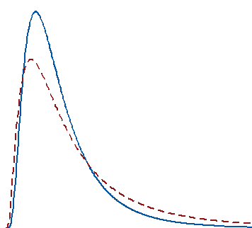
Reasons to Use Nonparametric Tests
The fact that you can perform a parametric test with non-normal data doesn’t imply that the mean is the best measure of the central tendency for your data.
For example, the center of a skewed distribution, like income, can be better measured by the median where 50% are above the median and 50% are below. If you add a few billionaires to a sample, the mathematical mean increases greatly even though the income for the typical person doesn’t change.
When your distribution is skewed enough, the mean is strongly affected by changes far out in the distribution’s tail whereas the median continues to more closely reflect the center of the distribution. For these two distributions, a random sample of 100 from each distribution produces means that are significantly different, but medians that are not significantly different.

Slide 20
Reasons to Use Nonparametric Tests
Reason 2: You have a very small sample size
If you are not confident that you have normally distributed data, you should use a nonparametric test. When you have a really small sample, you might not even be able to ascertain the distribution of your data because the distribution tests will lack sufficient power to provide meaningful results.
Reason 3: You have ordinal data, ranked data, or outliers that you can’t remove
Typical parametric tests can only assess continuous data and the results can be significantly affected by outliers. Conversely, some nonparametric tests can handle ordinal data, ranked data, and not be seriously affected by outliers.

Slide 21
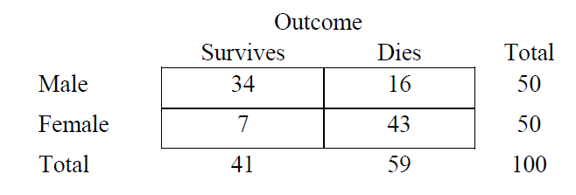
Nominal (Categorical) Data Analysis
If two variables are measured at the nominal level (categorical in nature), we assess their relationship by cross-tabulating the data in a contingency table.
A contingency table is a two-dimensional (rows x columns) table formed by 'cross-classifying' subjects or events on two categorical variables. One variable's categories define the rows while the other variable's categories define the columns. The intersection (cross-tabulation) of each row and column forms a cell, which displays the count (frequency) of cases classified as being in the applicable category of both variables.
Below is a simple example of a hypothetical contingency table that cross-tabulates patient gender against survival of chest trauma:

Slide 22
Decision Table for Inferential Statistical Tests Employed with Categorical/Nominal Data
Number of samples |  | Hypothesis evaluated | Test
Single sample |  | Hypothesis about distribution of data in a single population | Test 1 - The chi-square goodness-of-fit test Test 4 The binomial sign test for a single sample The z test for a population proportion Test 3b- The chi-square test of independence
Two samples | Two independent samples | Hypothesis about distribution of data in two independent populations | Test 3a- The chi-square test for homogeneity The Fisher exact test The z test for two independent proportions
 | Two dependent samples | Hypothesis about distribution of data in two dependent populations | The McNemar test
Two or more samples | Two or more independent samples | Hypothesis about distribution of data in two or more independent populations | Test 3a- The chi-square test for homogeneity
 | Two or more dependent samples | Hypothesis about distribution of of data in two or more dependent populations | The Cochran Q test

Slide 23
Decision Table for Inferential Statistical Tests Employed with Ordinal/Rank-Order Data
Number of samples |  | Hypothesis evaluated | Test
Single sample |  | Hypothesis about a population median or the distribution of data in a single population | Test5. The Wilcoxon signed-ranks test Test 2. The Kolmogorov–Smirnov goodness-of-fit test Test 6. The single-sample test for the median
Two samples | Two independent samples | Hypothesis about two independent population medians, or some other characteristic (other than variability) of two independent populations | Test7. The Mann–Whitney U test The Kolmogorov–Smirnov test for two independent samples The median test for independent samples
 | Two dependent samples | Hypothesis about the ordering of data in two dependent populations | Test8. The Wilcoxon matched-pairs signed-ranks test Test9. The binomial sign test for two dependent samples
Two or more samples | Two or more independent samples | Hypothesis about two or more independent population medians, or some other characteristic of two or more independent populations | Test10. The Kruskal–Wallis one-way analysis of variance
 | Two or more dependent samples | Hypothesis about two or more dependent population medians | Test11. The Friedman two-way analysis of variance

Slide 24
Chi-square tests
Categorical or nominal data involve calculating or keeping track of frequencies. If we had a group of 20 people, for example, we could describe them-and group them-based on arbitrary frequency information (e.g., How many had blue eyes? Green eyes? How many of the women are over 6 feet tall? How many group members have advanced degrees?).
Such information is usually easy to follow and interpret, but when we want to make inferences about the presence or absence of some pattern (e.g., Are there more women over 6 feet than under that height in the sample?) within the frequencies, then we need to rely on a statistical tool for analyzing frequencies.
The chi-square test, which compares observed frequencies against expected frequencies, is such a tool.

Slide 25
Chi-square tests
One underlying assumption the chi-square does have is that observations are randomly
selected from some larger population.
If the observations are not randomly selected-and many times they will not be-then a researcher must be very cautious about generalizing from the data set's results back to the larger population. After all, you cannot learn the social climate of a college campus by speaking to fraternity and sorority members exclusively- so-called "independent" students must be polled, as well.
A second assumption is that the number of expected observations within a given category should be reasonably large. A good rule of thumb is to have few (preferably no) categories with less than an expected frequency of 5 observations in any given analysis.

Slide 26
Chi-square GOODNESS OF FIT test
When working with nominal, also known as categorical, data, however, we are interested in exploring the relative frequencies or proportions present in some distribution
(e.g., How many experimental psychologists are males rather than females?
Of the four most popular majors at the college, which one do sophomores choose most often?).
Questions like these involve collecting frequency data and then making comparisons based on how the observations are categorized.
The statistical test designed to make such comparisons is commonly referred to as the chi-square test for goodness-of-fit.
The null hypothesis can take one of two forms: no frequency difference among a set of different categories or no frequency difference from a comparison population.
The alternative hypothesis states that: There is a statistically reliable difference between the observed and the expected frequencies.

Slide 27
1. The Chi-Square Goodness-of-Fit Test (Nonparametric Test Employed with Categorical/Nominal Data)
Hypothesis evaluated with test In the underlying population represented by a sample are the observed cell frequencies different from the expected cell frequencies?
The chi-square goodness-of-fit test, also referred to as the chi-square test for a single sample, is employed in a hypothesis testing situation involving a single sample.
Based on some preexisting characteristic or measure of performance, each of n observations (subjects/objects) that is randomly selected from a population consisting of N observations (subjects/objects) is assigned to one of k mutually exclusive categories.
The data are summarized in the form of a table consisting of k cells, each cell representing one of the k categories.

Slide 28
The experimental hypothesis evaluated with the chi-square goodness-of-fit test is whether or not there is a difference between the observed frequencies of the k cells and their expected frequencies (also referred to as the theoretical frequencies).
The expected frequency of a cell is determined through the use of probability theory or is based on some preexisting empirical information about the variable under study.
If the result of the chi-square goodness-of-fit test is significant, the researcher can conclude that in the underlying population represented by the sample there is a high likelihood that the observed frequency for at least one of the k cells is not equal to the expected frequency of the cell.
The chi-square goodness-of-fit test is based on the following assumptions:
Categorical/nominal data are employed in the analysis. This assumption reflects the fact that the test data should represent frequencies for k mutually exclusive categories;
The data that are evaluated consist of a random sample of n independent observations. This assumption reflects the fact that each observation can only be represented once in the data;
The expected frequency of each cell is 5 or greater.

Slide 29
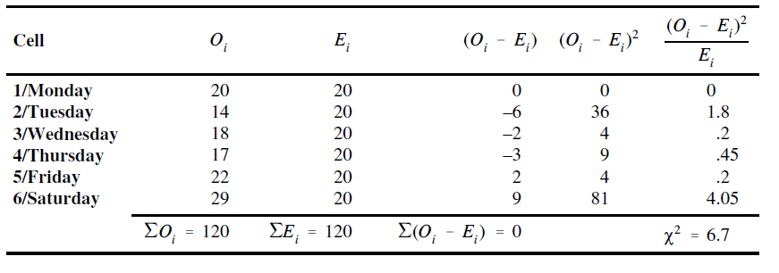
A librarian wishes to determine if it is equally likely that a person will take a book out of the library each of the six days of the week the library is open (assume the library is closed on Sundays). She records the number of books signed out of the library during one week and obtains the following frequencies: Monday, 20; Tuesday, 14; Wednesday, 18; Thursday, 17; Friday, 22; and Saturday, 29. Assume no person is permitted to take out more than one book during the week. Do the data indicate there is a difference with respect to the number of books taken out on different days of the week?
Null hypothesis: In the underlying population the sample represents, for each of the cells, the observed frequency of a cell is equal to the expected frequency of the cell.
Alternative hypothesis: In the underlying population the sample represents, for at least one of the k cells the observed frequency of a cell is not equal to the expected frequency of the cell.

Slide 30
The obtained value is evaluated with the Table of the Chi-Square Distribution.
The degrees of freedom that are employed in evaluating the results of the chi-square goodness-of-fit test df=k-1.
The tabled critical values for the chi-square goodness-of-fit test are always derived from the right tail of the distribution. Thus, the tabled critical .05 chi-square value (to be designated ) will be the tabled chi-square value at the 95th percentile.
df = 6 – 1 = 5
The tabled critical .05 chi-square value for df = 5 is Χ²_{0.05} =11.07, which, as noted above, is the tabled chi-square value at the 95th percentile.
Since the computed value Χ =6.7, is less than Χ²_{0.05} =11.07, the null hypothesis cannot be rejected at the .05 level.
Although there are some deviations between the observed and expected frequencies in, the result of the chi-square goodness-of-fit test indicates there is a reasonably high likelihood that the deviations in the sample data can be attributed to chance.

Slide 31
R code
#Chi-sqyare test of Goodness of fit
chisq.test(c(20,14,18,17,22,29), p=c(20,20,20,20,20,20)/120)
Chi-squared test for given probabilities
data: c(20, 14, 18, 17, 22, 29)
X-squared = 6.7, df = 5, p-value = 0.2439

Slide 32
A country in which four ethnic groups make up the population establishes affirmative action guidelines for medical school admissions. The country has one medical school, and it is mandated that each new class of medical students proportionally represents the four ethnic groups that comprise the country’s population. The four ethnic groups that make up the population and the proportion of people in each ethnic group are: Balzacs (.4), Crosacs (.25), Murads (.3), and Isads (.05).15 The number of students from each ethnic group admitted into the medical school class for the new year are: Balzacs (300), Crosacs (220), Murads (400), and Isads (80). Is there a significant discrepancy between the proportions mandated in the affirmative action guidelines and the actual proportion of the four ethnic groups in the new medical school class?
There are k = 4 cells — each cell representing one of the four mutually exclusive ethnic groups.
The observed frequencies are the number of students from each of the four ethnic groups out of the total of 1000 students who are admitted to the medical school (i.e., n = 300 + 220 + 400 + 80 = 1000). The expected frequencies are computed based upon the proportion of each ethnic group in the population. Each of these values is obtained by multiplying the total number of medical school admissions (1000) by the proportion of a specific ethnic group in the population.
Thus in the case of the Balzacs, the expected frequency is computed as follows: E1=1000*(0.4)=400.
df=4-1=3
Χ²_{0.05} =7.81
Since Χ =79.9>Χ²_{0.05} =7.81, the null hypothesis can be rejected at both the .05 level. Based on the chi-square analysis it can be concluded that the medical school admissions data do not adhere to the proportions mandated in the affirmative action guidelines.

Slide 33
R code
#Chi-sqyare test of Goodness of fit
chisq.test(c(300,220,400,80), p=c(400,250,300,50)/1000)
Chi-squared test for given probabilities
data: c(300, 220, 400, 80)
X-squared = 79.933, df = 3, p-value < 2.2e-16

Slide 34
A physician who specializes in genetic diseases develops a theory which predicts that two-thirds of the people who develop a disease called cyclomeiosis will be males. She randomly selects 300 people who are afflicted with cyclomeiosis and observes that 140 of them are females. Is the physician’s theory supported?
df=2-1=1
Χ²_{0.05} =3.84
Since Χ =24>Χ²_{0.05} =3.84, the null hypothesis can be rejected at both the .05 level. Based on the chi-square analysis it can be concluded that the observed distribution of males and females for the disease is not consistent with the doctor’s theory..

Slide 35
R code
#Chi-sqyare test of Goodness of fit
chisq.test(c(160,140), p=c(200,100)/300)
Chi-squared test for given probabilities
data: c(160, 140)
X-squared = 24, df = 1, p-value = 9.634e-07

Slide 36
Let's consider a specific example to illustrate the chi-square test for goodness-of-fit. A statistics instructor asks the 35 students in her class to complete a standard course evaluation. One of the key questions of interest to this instructor was: "Statistics was my favorite class this semester." To respond to the statement, a student simply circled one (and only one) of the rating options (i.e., strongly agree, agree, undecided, disagree, strongly disagree). Here is a breakdown of the students' responses (N = 35):
Ho: No difference in course ratings across the five rating categories(i.e., strongly agree to strongly disagree).
Because there are 35 students, the expected frequency for each category when no difference exists would be 7 (i.e., 35 students divided by the five possible categories equals 7 students in each one), or:

Slide 37
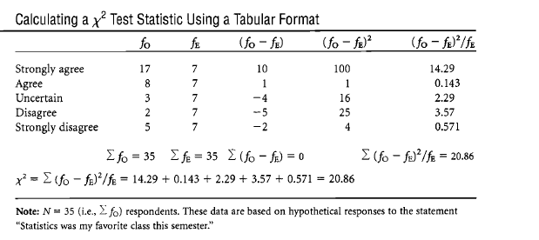
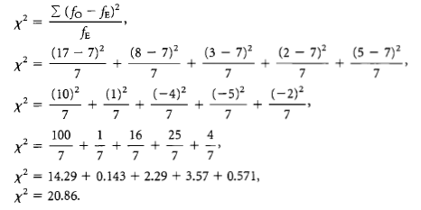
Thus, the general rule of thumb for determining the expected frequencies for the chi-square test for goodness-of-fit test is simply dividing N by the number of available categories.
The alternative hypothesis, then, is:
H1: There is a statistically reliable difference between the observed and the expected frequencies.
df_{x} = 5 – 1=4.
Is X² (4) = 20.86 ≥ X² _{critical} (4) = 9.488? Yes, so Reject Ho.

Slide 38
R code
#Chi-sqyare test of Goodness of fit
chisq.test(c(17,8,3,2,5), p=c(7,7,7,7,7)/35)
Chi-squared test for given probabilities
data: c(17, 8, 3, 2, 5)
X-squared = 20.857, df = 4, p-value = 0.000338

Slide 39
As shown by the original data, students enrolled in statistics that semester generally (and strongly) agreed with the sentiment that it was their favorite course.
When a X² test statistic is significant, "what you see is what you get“ where interpretation is
concerned.
Can we conclude that all students share this belief?
Certainly not. Aside from required courses-and statistics may be one-anytime students take a class they generally elect to be there, so they were not randomly selected from the larger population. We can be reasonably confident that students in this sample defied expectations-they did indeed like the course-but we cannot generalize beyond this sample.

Slide 40
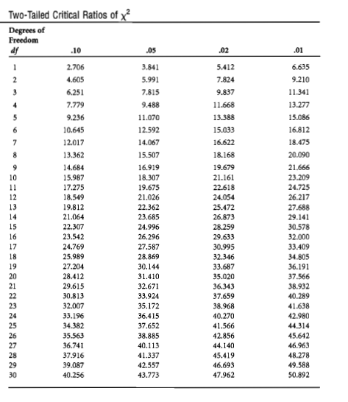

Slide 41
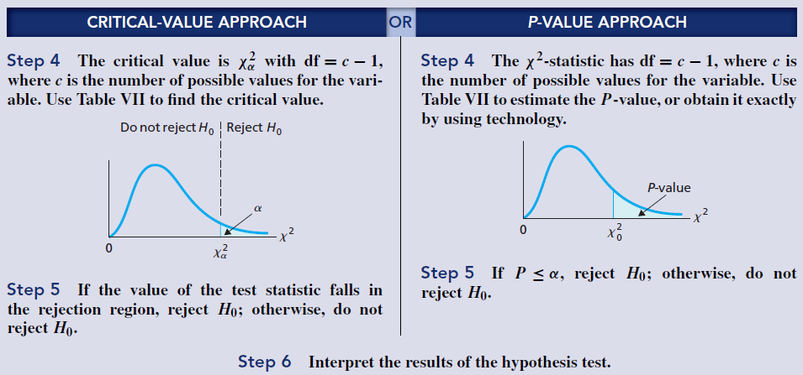

Slide 42
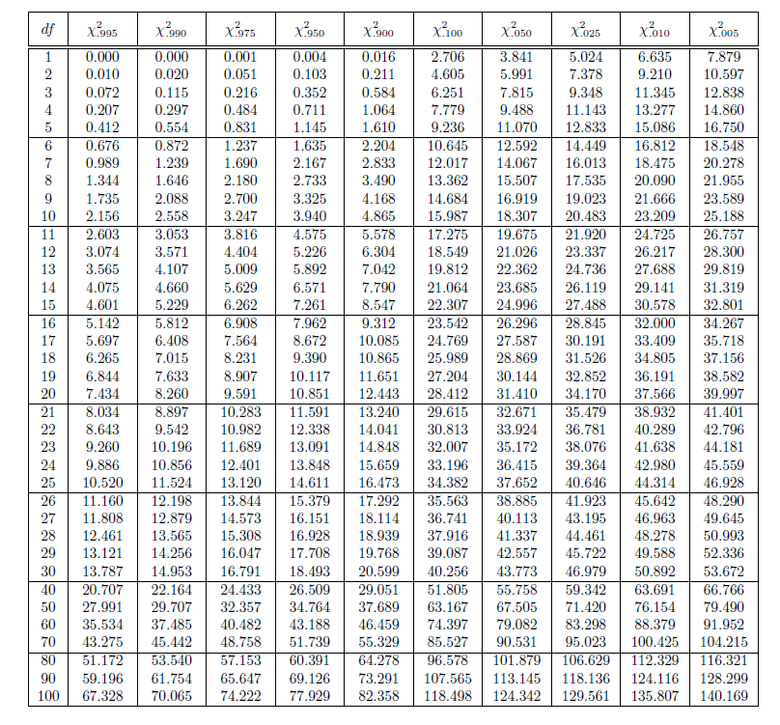

Slide 43
X² Goodness-of-Fit
Example : Credit Cards
At a major credit card bank, the percentages of people who historically apply for the
Silver, Gold, and Platinum cards are 60%, 30%, and 10% respectively. In a recent
sample of customers, 110 applied for Silver, 55 for Gold, and 35 for Platinum. Is there
evidence to suggest the percentages have changed?
We expect 60% of 200 people, or 120 people, to apply for the Silver card.
 | Silver | Gold | Platinum
Observed | 110 | 55 | 35
Expected | 120 | 60 | 20

Slide 44
X² Goodness-of-Fit
Using df = 2, from the Table the critical value is 10.595 <12.5, hence reject the null hypothesis. There is sufficient evidence that customers are not applying for cards in the traditional proportions. The distribution has changed over time.
> #Chi-sqyare test of Goodness of fit
> chisq.test(c(110,55,35), p=c(120,60,20)/200)
Chi-squared test for given probabilities
data: c(110, 55, 35)
X-squared = 12.5, df = 2, p-value = 0.00193

Slide 45
2. Kolmogorov–Smirnov goodness-of-fit test for a single sample
Null hypothesis: the researcher wants or expects to demonstrate that one or more samples come from a specific population or from the same population.
Alternative: the alternative hypothesis for a goodness-of fit test generally does not stipulate an alternative distribution that would become the most likely distribution for the data if the null hypothesis is rejected.
Unlike the chi-square goodness-of-fit test , the Kolmogorov–Smirnov goodness-of-fit test for a single sample is designed to be employed with a continuous variable

Slide 46
Kolmogorov–Smirnov goodness-of-fit test for a single sample
A researcher conducts a study to evaluate whether the distribution of the length of time it takes migraine patients to respond to a 100 mg. dose of an intravenously administered drug is normal, with a mean response time of 90 seconds and a standard deviation of 35 seconds (i.e.,μ = 90 and σ= 35). The amount of time (in seconds) that elapses between the administration of the drug and cessation of a headache for 30 migraine patients is recorded below. The 30 scores are arranged ordinally (i.e., from fastest response time to slowest response time).
21, 32, 38, 40, 48, 55, 63, 66, 70, 75, 80, 84, 86, 90, 90, 93, 95, 98, 100, 105, 106, 108, 115, 118, 126, 128, 130, 142, 145, 155
Do the data conform to a normal distributions with the specified parameters?
Note: The protocol for the Kolmogorov–Smirnov goodness of- fit test for a single sample requires that a cumulative probability distribution be constructed for both the sample distribution and the hypothesized population distribution.
H0: The distribution of data in the sample is consistent with the hypothesized theoretical population distribution.
Ha: The distribution of data in the sample is inconsistent with the hypothesized theoretical population distribution

Slide 47
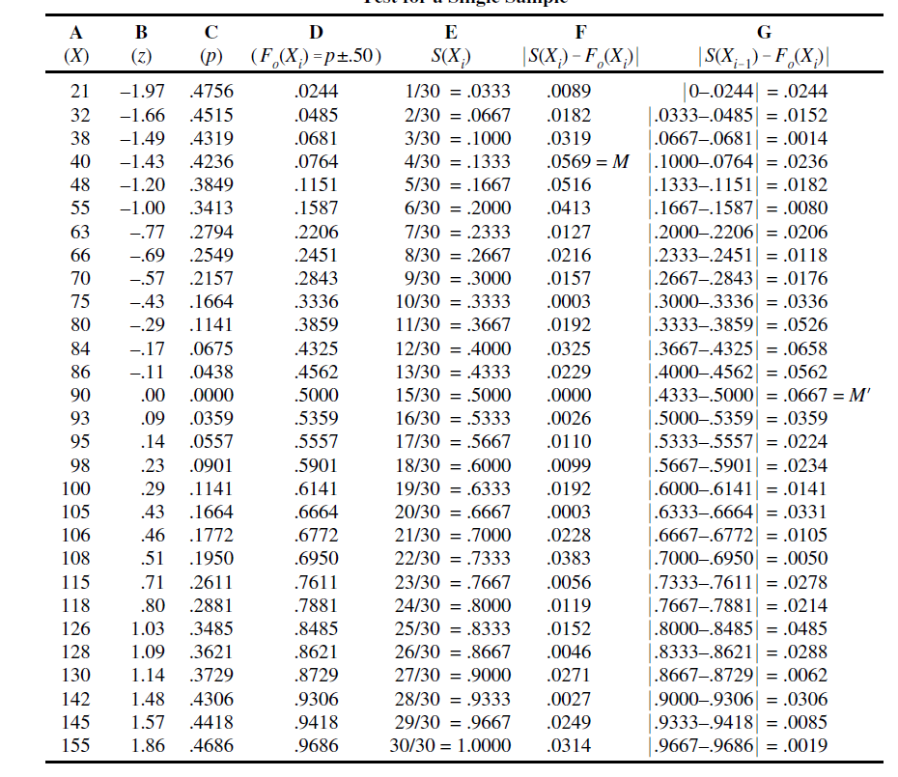
Kolmogorov–Smirnov goodness-of-fit test for a single sample
The null hypothesis is stating that the sample data are not derived from a normal distribution, with μ = 90 and = 35.
The values of the response time scores of the 30 subjects in the sample (i.e., the X scores) are recorded in Column A
Each value in Column B is the z score (i.e., a standard deviation score) that results when the X score in a given row is substituted in the equation z = (X – μ)/σ
Each value in Column C represents the proportion of cases in the normal distribution that falls between the population mean and the z score computed for the X score in a given row (
Each value in Column D represents the cumulative proportion for a given X score (and its associated z score) in the hypothesized theoretical distribution (i.e., in a normal distribution with
μ = 90 and = 35). To put it another way, if the decimal point is moved two places to the right, the value in Column D represents the percentile rank of a given X score in the hypothesized
theoretical distribution

Slide 48
Kolmogorov–Smirnov goodness-of-fit test for a single sample
T the test statistic for the Kolmogorov–Smirnov goodness-of-fit test for a single sample is defined by the greatest vertical distance at any point between the two cumulative probability distributions. The largest absolute value obtained in Column F will represent that value.
The largest absolute value is .0569, which is designated as the test statistic (represented by the notation M).
Each value in Column G is the absolute value of the difference between the proportion in Column D for a given row (i.e., F ) and the proportion in Column E for the preceding row.
Since it is assumed that the variable being evaluated is continuous, if there is a larger vertical distance for some score other than those in the sample, the latter score should represent the test statistic, instead of the M value recorded in Column F. The method for determining whether there is a larger vertical distance than the maximum value recorded in Column F is to compute the values in Column G

Slide 49
Kolmogorov–Smirnov goodness-of-fit test for a single sample
If the largest value computed in Column G (designated M') is larger than the M value computed in Column F, then M' is employed to represent the test statistic. In Table on pag 47, the largest value is .0667, and thus M' = .0667 becomes our test statistic.
Interpretation of the Test Results
The test statistic for the Kolmogorov–Smirnov goodness-of-fit test for a single sample is the larger of the two values M or M.
If at any point along the two cumulative probability distributions the greatest distance (i.e., the larger of the two values M or M) is equal to or greater than the tabled critical value recorded in Table A21 (next page), the null hypothesis is rejected.

Slide 50
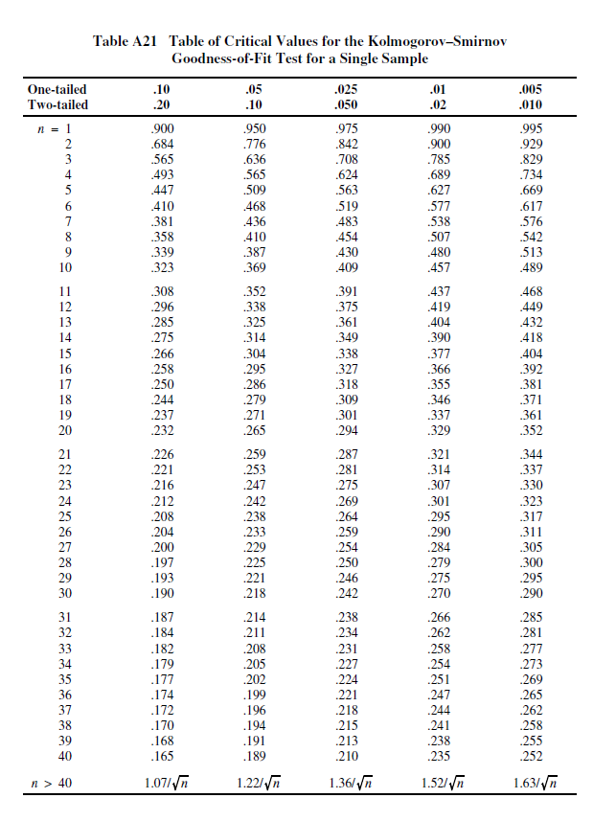

Slide 51
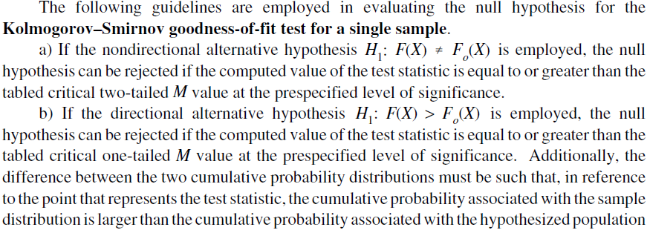
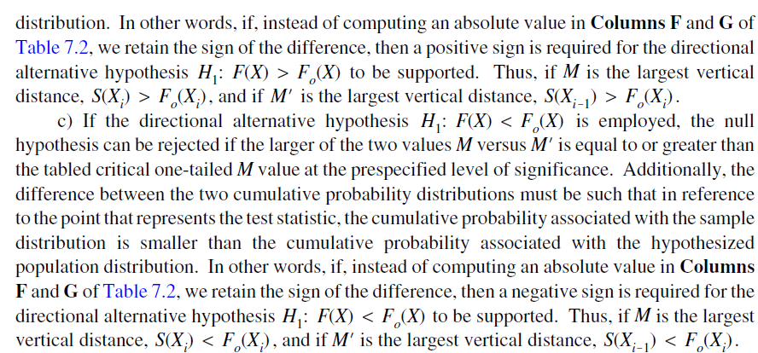

Slide 52
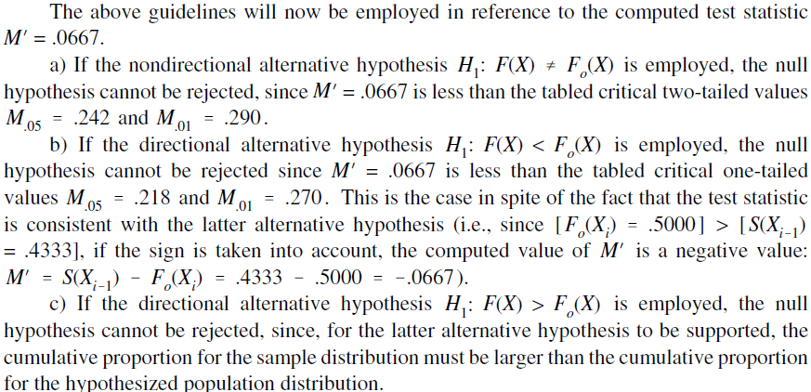
Kolmogorov–Smirnov goodness-of-fit test for a single sample
Conclusion: The data are consistent with the null hypothesis that the sample
is derived from a normally distributed population, with μ = 90 and σ= 35.

Slide 53
R code
#Kolmogorov-Smirnov test
x<-c(21, 32, 38, 40, 48, 55, 63, 66, 70, 75, 80, 84, 86, 90, 90, 93, 95, 98, 100, 105, 106, 108, 115, 118, 126, 128, 130, 142, 145, 155)
ks.test(x,"pnorm", m=90, sd=35)
One-sample Kolmogorov-Smirnov test
data: x
D = 0.066667, p-value = 0.9993
alternative hypothesis: two-sided

Slide 54
3. The Chi-Square Test for r × c Tables (Nonparametric Test Employed with Categorical/Nominal Data)
Hypothesis evaluated with test In the underlying population(s) represented by the sample(s) in a contingency table, are the observed cell frequencies different from the expected frequencies?
Relevant background information on test The chi-square test for r × c tables is one of a number of tests for which the chi-square distribution is the appropriate sampling distribution.
The chi-square test for r × c tables is an extension of the chi-square goodness-of-fit test to two-dimensional tables.
Whereas the latter test can only be employed with a single sample categorized on a single dimension (the single dimension is represented by the k cells/categories that comprise the frequency distribution table), the chi-square test for r × c tables can be employed to evaluate designs that summarize categorical data in the form of an r × c table (which is often referred to as a contingency table).

Slide 55
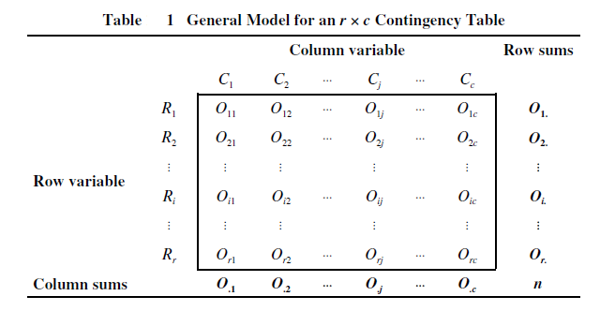
3. The Chi-Square Test for r × c Tables (Nonparametric Test Employed with Categorical/Nominal Data)
Table 1 presents the general model for an r × c contingency table. There are a total of n observations in the table. Note that each cell is identified with a subscript that consists of two elements.
The first element identifies the row in which the cell falls and the second element identifies the column in which the cell falls. Thus, the notation O_{ij} represents the number of observations in the cell that is in the i^{th} row and the j^{th} column.
O_{i} represents the number of observations in the i^{th} row and O_{j} represents the number of observations in the j^{th} column.

Slide 56
3. The Chi-Square Test for r × c Tables (Nonparametric Test Employed with Categorical/Nominal Data)
In actuality, there are two chi-square tests that can be conducted with an r × c table. The two tests that will be described are the chi-square test for homogeneity (Test 3a) and the chi-square test of independence (Test 3b).
The general label chi-square test for r × c tables will be employed to refer to both of the aforementioned tests, since the two tests are computationally identical.
Although, in actuality, the chi-square test for homogeneity and the chisquare test of independence evaluate different hypotheses, a generic hypothesis can be stated that is applicable to both tests. A brief description of the two tests follows.

Slide 57
The chi-square test for homogeneity (Test 3a)
The chi-square test for homogeneity is employed when r independent samples (where r≥2) are categorized on a single dimension which consists of c categories (where c≥2).
The data for the independent samples (which are generally represented by the r rows of the contingency table) are recorded with reference to the number of observations in each of the samples that fall within each of c categories (which are generally represented by the c columns of the contingency table).
It is assumed that each of the samples is randomly drawn from the underlying population it represents.
The chi-square test for homogeneity evaluates whether or not the r samples are homogeneous with respect to the proportion of observations in each of the c categories. To be more specific, if the data are homogeneous, the proportion of observations in the category will be equal in all of the r populations.
The chi-square test for homogeneity assumes that the sums of the r rows (which represent the number of observations in each of the r samples) are determined by the researcher prior to the data collection phase of a study.

Slide 58
The chi-square test of independence(Test 3b)
The chi-square test of independence is employed when a single sample is categorized on two dimensions/variables. It is assumed that the sample is randomly selected from the population it represents. One of the dimensions/variables is comprised of r categories (where r ≥ 2) that are represented by the r rows of the contingency table, while the second dimension/variable is comprised of c categories (where c ≥ 2) that are represented by the c columns of the contingency table.
The chi-square test of independence evaluates the general hypothesis that the two variables are independent of one another. Another way of stating that two variables are independent of one another is to say that there is a zero correlation between them.
A zero correlation indicates there is no way to predict at above chance in which category an observation will fall on one of the variables, if it is known which category the observation falls on the second variable.

Slide 59
The chi-square test for r × c tables (i.e., both the chi-square test for homogeneity and the chi-square test of independence) is based on the following assumptions:
Categorical/nominal data (i.e., frequencies) for r × c mutually exclusive categories are employed in the analysis;
The data that are evaluated represent a random sample comprised of n independent observations. This assumption reflects the fact that each subject or object can only be represented once in the data;
The expected frequency of each cell in the contingency table is 5 or greater. When the expected frequency of one or more cells is less than 5, the probabilities in the chi-square distribution may not provide an accurate estimate of the underlying sampling distribution.

Slide 60
Example. A researcher conducts a study in order to evaluate the effect of noise on altruistic behavior. Each of the 200 subjects who participate in the experiment is randomly assigned to one of two experimental conditions. Subjects in both conditions are given a one-hour test which is ostensibly a measure of intelligence.
During the test the 100 subjects in Group 1 are exposed to continual loud noise, which they are told is due to a malfunctioning generator.
The 100 subjects in Group 2 are not exposed to any noise during the test. Upon completion of this stage of the experiment, each subject on leaving the room is confronted by a middle-aged man whose arm is in a sling. The man asks the subject if she would be willing to help him carry a heavy package to his car. In actuality, the man requesting help is an experimental confederate (i.e., working for the experimenter).
The number of subjects in each group who help the man is recorded. Thirty of the 100 subjects who were exposed to noise elect to help the man, while 60 of the 100 subjects who were not exposed to noise elect to help the man. Do the data indicate that altruistic behavior is influenced by noise?

Slide 61
The data for the Example can be summarized in the form of a 2 × 2 contingency table
The appropriate test to employ for evaluating the Example is the chi-square test for homogeneity. This is the case, since the design of the study involves the use of categorical data (i.e., frequencies for each of the r × c cells in the contingency table) with multiple independent samples (specifically two) that are categorized on a single dimension (altruism).
To be more specific, the differential treatments to which the two groups are exposed (i.e., noise versus no-noise) constitute the independent variable.
The latter variable is the row variable, since it is represented by the two rows in the table. Note that the researcher assigns 100 subjects to each of the two levels of the independent variable prior to the data collection phase of the study. This is consistent with the fact that when the chi-square test for homogeneity is employed, the sums for the row variable are predetermined prior to collecting the data.

Slide 62
The dependent variable is whether or not a subject exhibits altruistic behavior. The latter variable is represented by the two categories helped the confederate versus did not help the confederate. The dependent variable is the column variable, since it is represented by the two columns in the table.
The hypothesis that is evaluated with the chi-square test for homogeneity is whether there is a difference between the two groups with respect to the proportion of subjects who help the confederate.

Slide 63
Conclusions: The significant chi-square value obtained for Example indicates that subjects who served in the noise condition helped the confederate significantly less than subjects who served in the no noise condition.
This can be confirmed by visual inspection of the contingency table, which reveals that twice as many subjects who served in the no noise condition helped the confederate than subjects who served in the noise condition.

Slide 64
Example2. A researcher wants to determine if there is a relationship between the personality dimension of introversion-extroversion and political affiliation. Two hundred people are recruited to participate in the study. All of the subjects are given a personality test on the basis of which each subject is classified as an introvert or an extrovert. Each subject is then asked to indicate whether he or she is a Democrat or a Republican.
The data for Example2, which can be summarized in the form of a 2 × 2 contingency table, are presented the next table. Do the data indicate there is a significant relationship between one’s political affiliation and whether or not one is an introvert versus an extrovert?

Slide 65
The appropriate test to employ for evaluating Example2 is the chi-square test of independence.
This is the case since:
a) The study involves a single sample that is categorized on two dimensions;
b) The data are comprised of frequencies for each of the r × c cells in the contingency table.
To be more specific, a sample of 200 subjects is categorized on the following two dimensions, with each dimension being comprised of two mutually exclusive categories:
a) introvert versus extrovert;
b) Democrat versus Republican.
In Example2 the introvert–extrovert dimension is the row variable and the Democrat–Republican dimension is the column variable.
Note that in selecting the sample of 200 subjects, the researcher does not determine beforehand the number of introverts, extroverts, Democrats, and Republicans to include in the study.
Thus, in Example 2 (consistent with the use of the chi-square test of independence) the sums of the rows and columns (which are referred to as the marginal sums) are not predetermined. The hypothesis that is evaluated with the chi-square test of independence is whether the two dimensions are independent of one another.

Slide 66
Even though the hypotheses evaluated with the chi-square test for homogeneity and the chisquare test of independence are not identical, generic null and alternative hypotheses employing common symbolic notation can be used for both tests.
The generic null and alternative hypotheses employ the observed and expected cell frequencies in the underlying population(s) represented by the sample(s). The observed and expected cell frequencies for the population(s) are represented respectively by the lower case Greek letters omicron (ο) and epsilon (ε).
Null hypothesis H₀: ο_{ij}= ε_{ij} for all cells
This notation indicates that in the underlying population(s) the sample(s) represent(s), for each of the r × c cells the observed frequency of a cell is equal to the expected frequency of the cell.
With respect to the sample data, this translates into the observed frequency of each of the r × c cells being equal to the expected frequency of the cell.

Slide 67
Alternative hypothesis: H₁: ο_{ij}≠ ε_{ij} for at least one cell
This notation indicates that in the underlying population(s) the sample(s) represent(s), for at least one of the r × c cells the observed frequency of a cell is not equal to the expected frequency of the cell.
With respect to the sample data, this translates into the observed frequency of at least one of the r × c cells not being equal to the expected frequency of the cell. This notation should not be interpreted as meaning that in order to reject the null hypothesis there must be a discrepancy between the observed and expected frequencies for all r × c cells.
Rejection of the null hypothesis can be the result of a discrepancy between the observed and expected frequencies for one cell, two cells, ..., or all r × c cells.)
Note: the alternative hypothesis will always be stated nondirectionally.

Slide 68
O₁₁=30 represents the number of subjects exposed to noise who helped the confederate.
O₁₂=70 represents the number of subjects exposed to noise who did not help the confederate
O₁₁=30 represents the number of introverts who are Democrats
O₁₂=70 represents the number of introverts who are Republicans

Slide 69
Alternative way of stating the null and alternative hypotheses for the chi-square test for homogeneity: If the independent variable (which represents the different groups) is employed as the row variable, the null and alternative hypotheses can be stated as follows:
H₀: In the underlying populations the samples represent, all of the proportions in the same column of the r × c table are equal
H₁: In the underlying populations t he samples represent, all of the proportions in the same column of the r × c table are not equal for at least one of the columns
Viewing the above hypotheses in relation to the sample data in Example1, the null hypothesis states that there are an equal proportion of observations in Cell11 and Cell21.
The null hypothesis also requires an equal proportion of observations in Cell12 and Cell22.

Slide 70
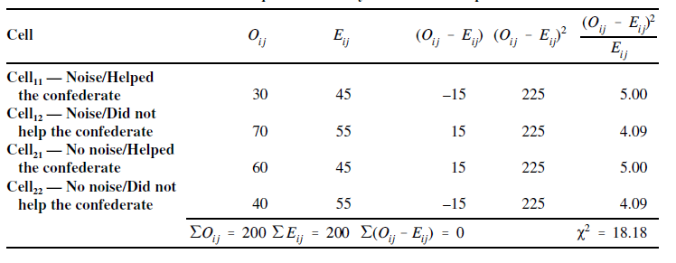
In order to conduct the chi-square test for r × c tables, the observed frequency for each cell must be compared with its expected frequency. In order to determine the expected frequency of a cell, the data should be arranged in a contingency table
The following protocol is then employed to determine the expected frequency of a cell:
a) Multiply the sum of the observations in the row in which the cell appears by the sum of the observations in the column in which the cell appears;
b) Divide n, the total number of observations, into the product that results from multiplying the row and column sums for the cell.

Slide 71
Upon determining the expected cell frequencies, the test statistic for the chi-square test for r × c tables is computed with
The obtained value X²=18.18 is evaluated with the critical values (see next slide).
The degrees of freedom employed for the analysis are computed as df=(r-1)*(c-1)
Since r = 2 and c = 2, the degrees of freedom are computed to be df=1.
The tabled critical .05 chi-square value for df = 1 is X²_{.05} =3.84.
Since the computed value X²=18.18 is greater than the critical value is X²_{.05} =3.84, the null hypothesis can be rejected at the .05 level of significance.
Rejection of the null hypothesis at the .05 level can be summarized as follows:
X² ₍₁₎ =18.18, p<.05

Slide 72
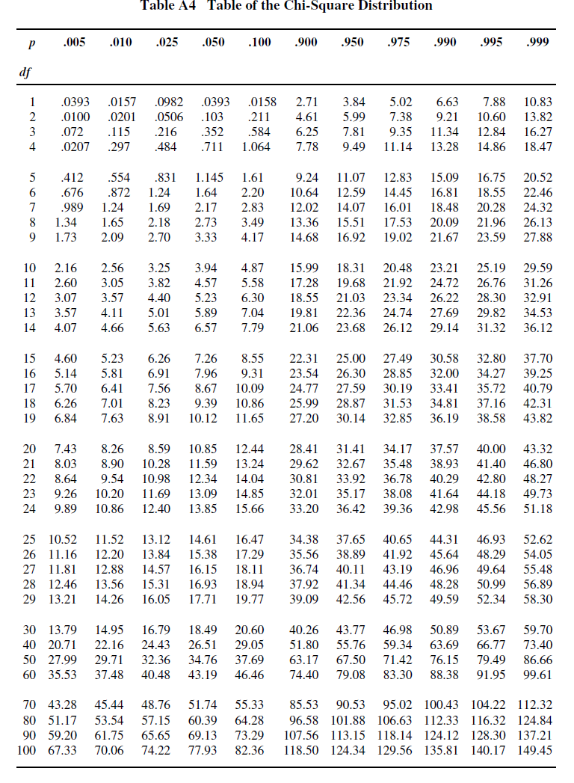

Slide 73
R code
# chi-square test for homogeneity
table3a=matrix(c(30,60,70,40),ncol=2)
rownames(table3a)=c("Noise","no noise")
colnames(table3a)=c("helped","didn't help")
table3a
helped didn't help
Noise 30 70
no noise 60 40
> chisq.test(table3a, correct = FALSE)
Pearson's Chi-squared test
data: table3a
X-squared = 18.182, df = 1, p-value = 2.008e-05

Slide 74
Alternative way of stating the null and alternative hypotheses for the chi-square test of independence : The null and alternative hypotheses for the chi-square test of independence can be stated as follows:
H₀: π_{ij}= π_{i. *} π._{j} or all r × c cells.
H₁: π_{ij} ≠ π_{i. *} π._{j} or at least one cell.
The above notation indicates that if the null hypothesis is true, in the underlying population represented by the sample for each of the r × c cells, the proportion of observations in a cell will equal the proportion of observations in the row in which the cell appears multiplied by the proportion of observations in the column in which the cell appears.
If the null hypothesis is true, in Example2, in the case of Cell11 it is required that the proportion of observations in Cell11 is equivalent to the product of the proportion of observations in Row 1 (which equals p_{1.}= O_{1.}/n=100/200=.5) and the proportion of observations in Column 1 (which equals p.₁= O.₁/n=90/200=.45).
The result of multiplying the row and column proportions is p_{1.}* p.₁=(.5)*(.45)=.225

Slide 75
As noted previously, the chi-square analysis described in this section also applies to Example2, since the latter example employs the same data as Example1.
Thus, with respect to Example2, the significant X²=18.18 value allows the researcher to conclude that a subject’s categorization on the introvert–extrovert dimension is associated with (i.e., not independent of) one’s political affiliation.
This can be confirmed by visual inspection of the contingency table which reveals that introverts are more likely to be Republicans whereas extroverts are more likely to be Democrats.

Slide 76
Observations: It is important to note that Example2 represents a correlational study, and as such does not allow a researcher to draw any conclusions with regard to cause and effect.
To be more specific, the study does not allow one to conclude that a subject’s categorization on the personality dimension introvert–extrovert is the cause of one’s political affiliation (Democrat versus Republican), or vice versa (i.e., that political affiliation causes one to be an introvert versus an extrovert).
When studies which are evaluated with the chi-square test of independence (such as Example2) yield a significant result, one can only conclude that in the underlying population the two variables have a correlation with one another that is some value other than zero (which is not commensurate with saying that one variable causes the other).

Slide 77
R code
# chi-square test for independence
table3b=matrix(c(30,60,70,40),ncol=2)
colnames(table3b)=c("Democrat", "Republican")
rownames(table3b)=c("Introvert", "Extrovert")
table3b
Democrat Republican
Introvert 30 70
Extrovert 60 40
> chisq.test(table3b, correct=FALSE)
Pearson's Chi-squared test
data: table3b
X-squared = 18.182, df = 1, p-value = 2.008e-05

Slide 78
Yates’ correction for continuity
In actuality, the chi-square test for r × c tables employs a continuous distribution to approximate a discrete probability distribution. Under such conditions, some sources recommend that a correction for continuity be employed.
The correction for continuity is based on the premise that if a continuous distribution is employed to estimate a discrete distribution, such an approximation will inflate the Type I error rate.
Sources that recommend the correction for continuity for the chisquare test for r × c tables only recommend that it be employed in the case of 2 × 2 contingency tables.
X² ₍₁₎ =4.67+3.82+4.67+3.82=16.99

Slide 79
R code
# chi-square test for homogeneity
table3a=matrix(c(30,60,70,40),ncol=2)
rownames(table3a)=c("Noise","no noise")
colnames(table3a)=c("helped","didn't help")
table3a
helped didn't help
Noise 30 70
no noise 60 40
> chisq.test(table3a)
Pearson's Chi-squared test with Yates' continuity correction
data: table3a
X-squared = 16.99, df = 1, p-value = 3.758e-05

Slide 80
4. The Binomial Sign Test for a Single Sample
Hypothesis evaluated with test: In an underlying population comprised of two categories that is represented by a sample, is the proportion of observations in one of the two categories equal to a specific value?
The binomial sign test for a single sample is based on the binomial distribution.
The basic assumption underlying the binomial distribution is that each of n independent observations (i.e., the outcome for any given observation is not influenced by the outcome for any other observation) is randomly selected from a population, and that each observation can be classified in one of k = 2 mutually exclusive categories.
The binomial sign test for a single sample employs the binomial distribution to determine the likelihood that x or more (or x or less) of n observations that comprise a sample will fall in one of two categories.
When there are k = 2 categories, the hypothesis evaluated with the binomial sign test for a single sample is identical to that evaluated with the chi-square goodness-of-fit test

Slide 81
The Binomial Sign Test for a Single Sample
Example 4.1 An experiment is conducted to determine whether a coin is biased. The coin is flipped ten times resulting in eight heads and two tails. Do the results indicate that the coin is biased?
Example 4.2 Ten women are asked to judge which of two brands of perfume has a more fragrant odor. Eight of the women select Perfume A and two of the women select Perfume B.Is there a significant difference with respect to preference for the perfumes?
Null hypothesis H0: π₁=0.5
(In the underlying population the sample represents, the true proportion of observations in Category 1 equals .5.)
Alternative hypothesis H1: π₁ ≠0.5
(In the underlying population the sample represents, the true proportion of observations in Category 1 is not equal to .5. This is a nondirectional alternative hypothesis, and it is evaluated with a two-tailed test.
In order to be supported, the observed proportion of observations in Category 1 in the sample data (which will be represented with the notation p₁ ) can be either significantly larger than the hypothesized population proportion π₁₌0.5 or significantly smaller than π₁₌0.5.

Slide 82
The Binomial Sign Test for a Single Sample
In Example 4.1 the null and alternative hypotheses reflect the fact that it is assumed that if one is employing a fair coin, the probability of obtaining Heads in any trial will equal .5 (which is equivalent to 1/2).
Thus, the expected/theoretical probability for Heads is represented by π₁=0.5 .
If the coin is fair, the probability of obtaining Tails in any trial will also equal π₁=0.5, and thus the expected/theoretical probability for Tails is represented by π₂=0.5 .
Note that π₁+ π₂=1

Slide 83
The Binomial Sign Test for a Single Sample
In Example 4.2, it is assumed that if there is no difference with regard to preference for the two brands of perfume, the likelihood of a woman selecting Perfume A will equal π₁=0.5 and the likelihood of selecting Perfume B will equal π₂=0.5.
In both Examples 9.1 and 9.2 the question that is being asked is as follows: If n = 10 and π₁= π₂=0.5, what is the probability of 8 or more observations in one of the two categories?
In Examples 9.1 and 9.2, the proportion of observations in Category/Cell 1 is p₁ = 8/10=.8 (i.e., p₁ = n₁/n, where n₁ is the number of observations in Category 1), and the proportion of observations in Category/Cell2 is p₂ = 2/10=.2 (i.e., p₂ = n₂/n, where n₂ is the number of observations in Category 2).

Slide 84
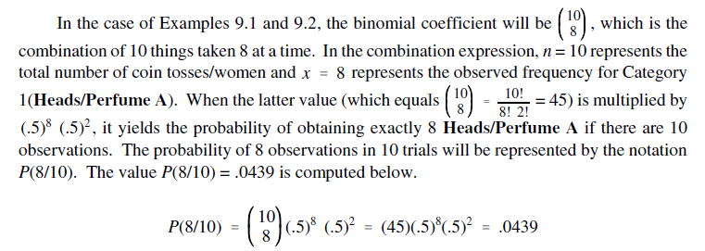
The Binomial Sign Test for a Single Sample
The following equation can be employed to compute the probability that exactly x out of a total of n observations will fall in one of the two categories

Slide 85
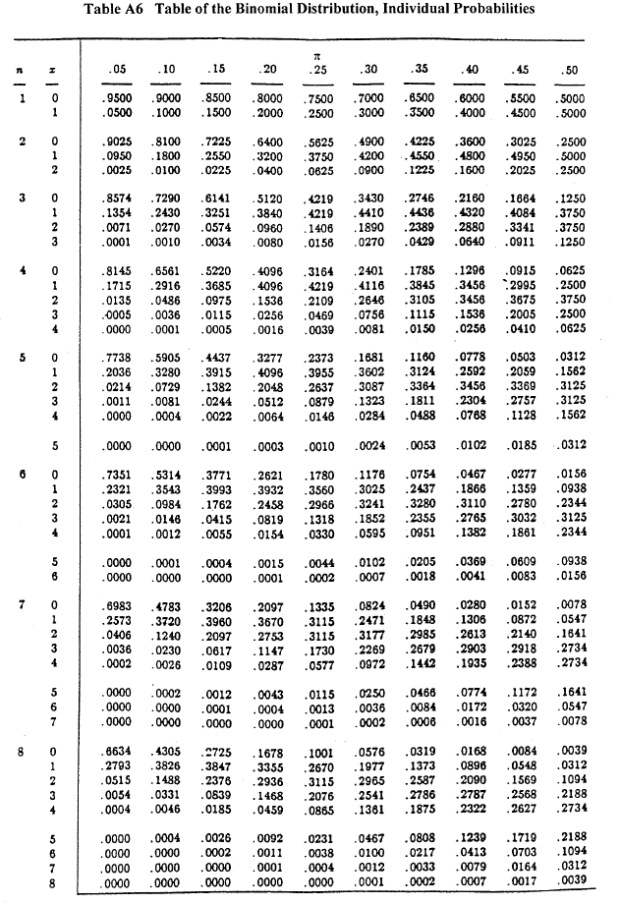

Slide 86
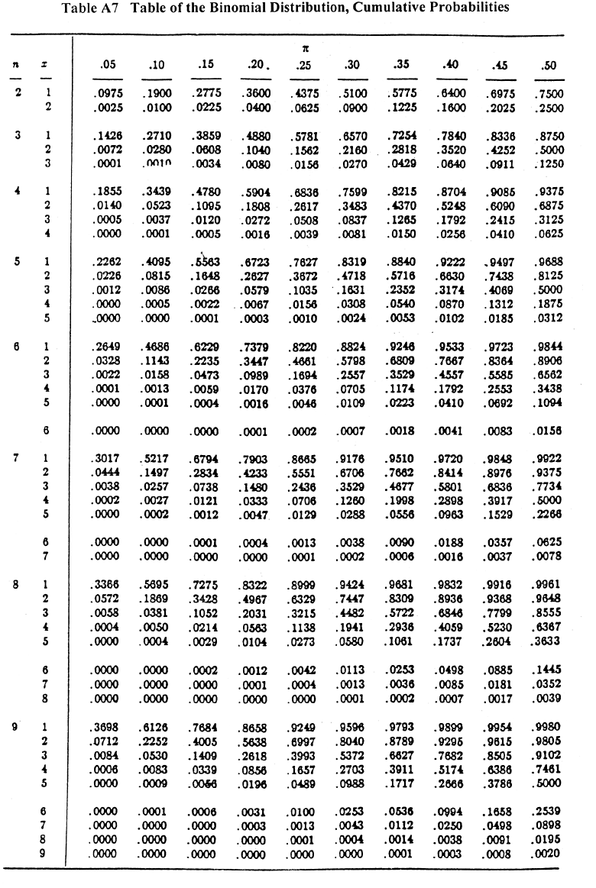

Slide 87
When the binomial sign test for a single sample is applied to Examples 4.1 and 4.2, it provides a probabilistic answer to the question of whether or not p₁= 8/10=.8 (i.e., the observed proportion of cases for Category 1) deviates significantly from the value π₁=.5 stated in the null hypothesis.
The following guidelines are employed in evaluating the null hypothesis.
If a nondirectional alternative hypothesis is employed, the null hypothesis can be rejected if the probability of obtaining a value equal to or more extreme than x is equal to or less than α /2 (where α represents the prespecified value of α ).
If a directional alternative hypothesis is employed that predicts the underlying population proportion is above a specified value, to reject the null hypothesis both of the following conditions must be met:
The proportion of cases observed in Category 1 (p₁) must be greater than the value of π₁ stipulated in the null hypothesis;
The probability of obtaining a value equal to or greater than x is equal to or less than the prespecified value of α.
If a directional alternative hypothesis is employed that predicts the underlying population proportion is below a specified value, to reject the null hypothesis both of the following conditions must be met:
The proportion of cases observed in Category 1 (p₁) must be less than the value of π₁ stipulated in the null hypothesis;
The probability of obtaining a value equal to or less than x is equal to or less than the prespecified value of α.

Slide 88
Examples 4.1 and 4.2:
If α = .05, the nondirectional alternative hypothesis H₁: π₁≠.5 is not supported, since the obtained probability .0547 is greater than α /2 = .05/2 = .025.
If α = .05, the directional alternative hypothesis H₁: π₁>.5 is not supported, since the obtained probability .0547 is greater than α = .05.
The directional alternative hypothesis H₁: π₁<.5 is not supported, since p₁=.8 is larger than the value π₁=.5 predicted in the null hypothesis.
To summarize, the results of the analysis of Examples 4.1 and 4.2 do not allow a researcher to conclude that the true population proportion is some value other than .5.
In Example 4.1 the data do not allow one to conclude that the coin is biased.
In Example 4.2, the data do not allow one to conclude that women exhibit a preference for one of the two brands of perfume.
Observation: It should be noted that if the obtained proportion p₁=.8 had been obtained with a larger sample size, the null hypothesis could be rejected.

Slide 89
The z test for a population proportion When the size of the sample is large the test statistic for the binomial sign test for a single sample can be approximated with the chisquare distribution — specifically, through use of the chi-square goodness-of-fit test.
An alternative and equivalent approximation can be obtained by using the normal distribution.
When the latter distribution is employed to approximate the test statistic for the binomial sign test for a single sample, the test is referred to as the z test for a population proportion.
The null and alternative hypotheses employed for the z test for a population proportion are identical to those employed for the binomial sign test for a single sample.
The test statistic for the z test for a population proportion is computed with

Slide 90
Example 4.3 An experiment is conducted to determine if a coin is biased. The coin is flipped 200 times resulting in 96 heads and 104 tails. Do the results indicate that the coin is biased?
Example 4.4 Although a senator supports a bill which favors a woman’s right to have an abortion,she realizes her vote could influence whether or not the people in her state endorse her bid for reelection. In view of this she decides that she will not vote in favor of the bill unless at least 50% of her constituents support a woman’s right to have an abortion. A random survey of 200 voters in her district reveals that 96 people are in favor of abortion. Will the senator support the bill?
Example 4.5 In order to determine whether or not a subject exhibits extrasensory ability, a researcher employs a list of 200 binary digits (specifically, the values 0 and 1) which have been randomly generated by a computer. The researcher conducts an experiment in which one of his assistants concentrates on each of the digits in the order it appears on the list. While the assistant does this, the subject, who is in another room, attempts to guess the value of the number for each of the 200 trials. The subject correctly guesses 96 of the 200 digits. Does the subject exhibit evidence of extrasensory ability?

Slide 91
The following guidelines are employed in evaluating the null hypothesis.
If the alternative hypothesis employed is nondirectional, the null hypothesis can be rejected if the obtained absolute value of z is equal to or greater than the tabled critical two-tailed value at the prespecified level of significance.
b) If the alternative hypothesis employed is directional and predicts a population proportion larger than the value stated in the null hypothesis, the null hypothesis can be rejected if the sign of z is positive and the value of z is equal to or greater than the tabled critical one-tailed value at the prespecified level of significance.
c) If the alternative hypothesis employed is directional and predicts a population proportion smaller than the value stated in the null hypothesis, the null hypothesis can be rejected if the sign of z is negative and the absolute value of z is equal to or greater than the tabled critical one-tailed value at the prespecified level of significance.

Slide 92
For Examples 4.3–4.5, based on the null hypothesis we know that: π₁ =.5 and π₂ = 1- π₁=.5. From the information that has been provided, we can compute the following values: p₁=96/200=.48 and p₂=(200-96)/200=.52 .
Therefore
And z=-.57 is compared with the critical value from the tables (consider α = .01 ) z_{.01}=2.58 and consider a nondirectional hypothesis.
Since |z|=.57 < z_{.01}=2.58, the null hypothesis cannot be rejected regardless of which of
the three possible alternative hypotheses is employed.

Slide 93
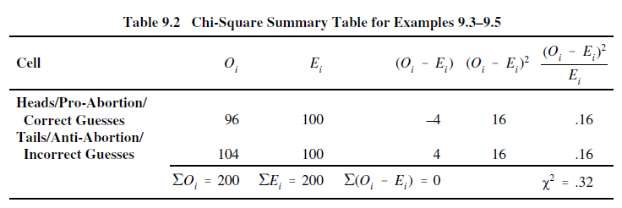
It was noted previously that when there are k = 2 categories, the chi-square goodness-of-fit test also provides a large sample approximation of the test statistic for the binomial sign test for a single sample.
In point of fact, the large sample approximation based on the chi-square goodness-of-fit test will yield results that are equivalent to those obtained with the z test for a population proportion, and the relationship between the computed chi-square value and the obtained z value for the same set of data will always be Χ²=z²
For df = 1, the tabled critical .01 chi-square value is Χ_{.01}²=6.63. Since the obtained value is Χ²=.32 is less than Χ_{.01}²=6.63, the null hypothesis cannot be rejected if the nondirectional alternative hypothesis H is employed.
To summarize, the results of the analysis for Examples 4.3–4.5 do not allow one to conclude that the true population proportion is some value other than 0.5.
In Example 4.5 the data do not allow one to conclude that the subject exhibited extrasensory abilities.

Slide 94
5. The Wilcoxon Signed-Ranks Test (Nonparametric Test Employed with Ordinal Data)
Hypothesis evaluated with test: Does a sample of n subjects (or objects) come from a population in which the median value (θ) equals a specified value?
If the Wilcoxon signed-ranks test yields a significant result, the researcher can conclude there is a high likelihood the sample is derived from a population with a median value other than θ.
The Wilcoxon signed-ranks test is based on the following assumptions:
a) The sample has been randomly selected from the population it represents;
b) The original scores obtained for each of the subjects/objects are in the format of interval/ratio data; and
c) The underlying population distribution is symmetrical.

Slide 95
5. The Wilcoxon Signed-Ranks Test (Nonparametric Test Employed with Ordinal Data)
When there is reason to believe that the latter assumption is violated, Daniel (1990), among others, recommends that the binomial sign test for a single sample (Test 4) be employed in place of the Wilcoxon signed-ranks test.
The Wilcoxon signed-ranks test, however, does not rank subjects’ original interval/ratio scores, but instead ranks difference scores — specifically, the obtained difference between each subject’s score and the hypothesized value of the population median.

Slide 96
5. The Wilcoxon Signed-Ranks Test (Nonparametric Test Employed with Ordinal Data)
Example 5.1 A physician states that the median number of times he sees each of his patients during the year is five. In order to evaluate the validity of this statement, he randomly selects ten of his patients and determines the number of office visits each of them made during the past year.
He obtains the following values for the ten patients in his sample: 9, 10, 8, 4, 8, 3, 0, 10, 15, 9. Do the data support his contention that the median number of times he sees a patient is five?

Slide 97
5. The Wilcoxon Signed-Ranks Test (Nonparametric Test Employed with Ordinal Data)
Null hypothesis: H₀: θ=5
(The median of the population the sample represents equals 5. With respect to the sample data, this translates into the sum of the ranks of the positive difference scores being equal to the sum of the ranks of the negative difference scores (i.e., ∑R+ = ∑R–).)
Alternative hypothesis : H₀: θ≠5
(The median of the population the sample represents does not equal 5. With respect to the sample data, this translates into the sum of the ranks of the positive difference scores not being equal to the sum of the ranks of the negative difference scores (i.e., ∑R+≠ ∑R–).
This is a nondirectional alternative hypothesis and it is evaluated with a two-tailed test.)

Slide 98
Alternative hypothesis : H₁: θ>5
(The median of the population the sample represents is some value greater than 5. With respect to the sample data, this translates into the sum of the ranks of the positive difference scores being greater than the sum of the ranks of the negative difference scores (i.e., ∑R+ > ∑R–).
This is a directional alternative hypothesis and it is evaluated with a one-tailed test.)
H₁: θ< 5
(The median of the population the sample represents is some value less than 5. With respect to the sample data, this translates into the sum of the ranks of the positive difference scores being less than the sum of the ranks of the negative difference scores (i.e., ∑R+ < ∑R–).
This is a directional alternative hypothesis and it is evaluated with a one-tailed test.)
Note: Only one of the above noted alternative hypotheses is employed. If the alternative hypothesis the researcher selects is supported, the null hypothesis is rejected.

Slide 99
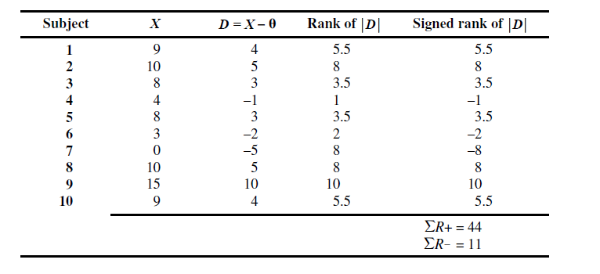
In column 3, a score is computed for each subject. This score, which is referred to as a difference score, is the difference between a subject’s score and the hypothesized value of the population median, θ =5.
Column 4 contains the ranks of the difference scores. In ranking the difference scores for the Wilcoxon signed-ranks test, the following guidelines are employed:

Slide 100
a) The absolute values of the difference scores (|D|) are ranked (i.e., the sign of a difference score is not taken into account).
b) Any difference score that equals zero is not ranked. This translates into eliminating from the analysis any subject who yields a difference score of zero.
c) In ranking the absolute values of the difference scores, the following protocol should be employed: Assign a rank of 1 to the difference score with the lowest absolute value, a rank of 2 to the difference score with the second lowest absolute value, and so on until the highest rank is assigned to the difference score with the highest absolute value. When there are tied scores present, the average of the ranks involved is assigned to all difference scores tied for a given rank.
The difference score of Subject 4 has the lowest absolute value (i.e., 1), and because of this it is assigned a rank of 1. The next lowest absolute value for a difference score (2) is that of Subject 6, and thus it is assigned a rank of 2.

Slide 101
It should be emphasized that in the Wilcoxon signed-ranks test it is essential that a rank of 1 be assigned to the difference score with the lowest absolute value, and that the highest rank be assigned to the difference score with the highest absolute value.
In most other tests that involve ranking, the ranking procedure can be reversed (i.e., the same test statistic will be obtained if one assigns a rank of 1 to the highest score and the highest rank to the lowest score).
However, if one reverses the ranking procedure in conducting the Wilcoxon signed-ranks test, it will invalidate the results of the test.
d) After ranking the absolute values of the difference scores, the sign of each difference score is placed in front of its rank.
The sum of the ranks that have a positive sign (i.e., ∑R+ = 44) and the sum of the ranks that have a negative sign (i.e., ∑R– = 11) are recorded at the bottom of the Column 5.
Note that

Slide 102
It is important to note that in the event one or more subjects obtains a difference score of zero, such scores are not employed in the analysis.
In such a case, the value of n in the previous equation will only represent the number of scores that have been assigned ranks.
As noted, if the sample is derived from a population with a median value equal to the hypothesized value of the population median (i.e., the null hypothesis is true), the values of ∑R+ and ∑R– will be equal to one another.
When ∑R+ and ∑R– are equivalent, both of these values will equal [n(n + 1)]/4. This latter value is commonly referred to as the expected value of the Wilcoxon T statistic.
If the value of ∑R+ is significantly greater than the value of ∑R–, it indicates there is a high likelihood the sample is derived from a population with a median value which is larger than the hypothesized value of the population median.
On the other hand, if ∑R– is significantly greater than ∑R+, it indicates there is a high likelihood the sample is derived from a population with a median value that is less than the hypothesized value of the population median.

Slide 103
The fact that ∑R+ = 44 is greater than ∑R– = 11 indicates that the data are consistent with the directional alternative hypothesis H₁: θ>5 .
The question is, however, whether the difference is significant — i.e., whether it large enough to conclude that it is unlikely to be the result of chance.
The absolute value of the smaller of the two values ∑R+ versus ∑R– is designated as the Wilcoxon T test statistic. Since ∑R– = 11 is smaller than ∑R+ = 44, T = 11.
The T value is interpreted by employing Table A5 (Table of Critical T Values for Wilcoxon’s Signed-Ranks and Matched-Pairs Signed-Ranks Tests)
In order to be significant, the obtained value of T must be equal to or less than the tabled critical T value at the prespecified level of significance

Slide 104
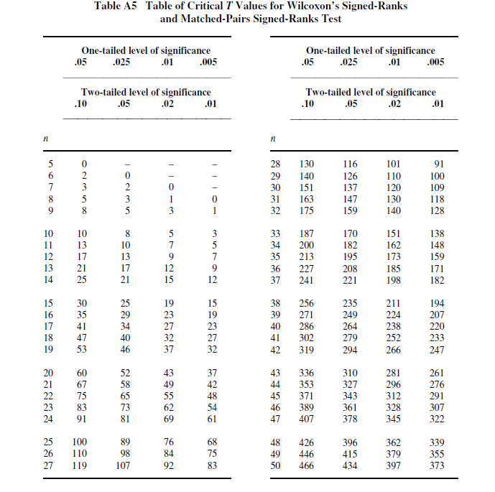

Slide 105
Since the null hypothesis can only be rejected if the computed value T = 11 is equal to or less than the tabled critical value at the prespecified level of significance, we can conclude the following.
In order for the nondirectional alternative hypothesis to be supported, it is irrelevant whether ∑R+ > ∑R– or ∑R– > ∑ +.
In order for the result to be significant, the computed value of must be equal to or less than the tabled critical two-tailed value at the prespecified level of significance.
Since the computed value T = 11 is greater than the tabled critical two-tailed .05 value T_{.05} = 8, the nondirectional alternative hypothesis is not supported at the .05 level.
It is also not supported at the .01 level, since T = 11 is greater than the tabled critical two-tailed .01 value T_{.01} = 3.

Slide 106
A summary of the analysis with the Wilcoxon signed-ranks test follows:
With respect to the median number of times the doctor sees a patient, we can conclude that the data do not indicate that the sample of 10 subjects comes from a population with a median value other than 5.

Slide 107
R code
# Wilcoxon signed-ranks test
> x<-c(9, 10, 8, 4, 8, 3, 0, 10, 15, 9)
> wilcox.test(x, mu = 5, alternative = "two.sided")
Wilcoxon signed rank test with continuity correction
data: x
V = 44, p-value = 0.1016
alternative hypothesis: true location is not equal to 5
Warning message:
In wilcox.test.default(x, mu = 5, alternative = "two.sided") :
cannot compute exact p-value with ties

Slide 108
Example 5.2 A physician states that the median number of times he sees each of his patients during the year is five. In order to evaluate the validity of this statement he randomly selects 13 of his patients and determines the number of office visits each of them made during the past year.
He obtains the following values for the 13 patients in his sample: 5, 9, 10, 8, 4, 8, 5, 3, 0, 10, 15, 9, 5. Do the data support his contention that the median number of times he sees a patient is five?
Examination of the data for Example 5.2 reveals that three of the 13 patients visited the doctor five times during the year. Since each of these three scores is equal to the hypothesized value of the population median, they will all produce difference scores of zero.
In employing the ranking protocol for the Wilcoxon signed-ranks test, all three of these scores will be eliminated from the data analysis.
Upon elimination of the three scores, the following ten scores remain:
9, 10, 8, 4, 8, 3, 0, 10, 15, 9.

Slide 109
Example 5.3 A college English instructor reads in an educational journal that the median number of times a student is absent from a class that meets for fifty minutes three times a week during a 15 week semester is = 5. During the fall semester she keeps a record of the number of times each of the 10 students in her writing class is absent. She obtains the following values: 9, 10, 8, 4, 8, 3, 0, 10, 15, 9. Do the data suggest that the class is representative of a population that has a median of 5?

Slide 110
6. The single-sample test for the median
There are occasions when the binomial sign test for a single sample is employed to evaluate a hypothesis regarding a population median.
Specifically, the test may be used to determine the likelihood of observing a specified number of scores above versus below the median of a distribution. When the binomial sign test for a single sample is used within this context it is often referred to as the single-sample test for the median.
Example 6.1 Assume that the median blood cholesterol level for a healthy 30-year-old male is 200 mg/100 ml. Blood cholesterol readings are obtained for a group consisting of eleven 30- year-old men who have had a heart attack within the last month. The blood cholesterol scores of the eleven men are: 230, 167, 250, 345, 442, 190, 200, 248, 289, 262, 301. Can one conclude that the median cholesterol level of the population represented by the sample (i.e., recent male heart attack victims) is some value other than 200?

Slide 111
6. The single-sample test for the median
Since the median identifies the 50th percentile of a distribution, if the population median is in fact equal to 200, one would expect one-half of the sample to have a blood cholesterol reading above 200 (i.e., p₁=.5 ), and one-half of the sample to have a reading below 200 (i.e., p₂=.5).
The null hypothesis and the nondirectional alternative hypothesis for 2 .5 Example 6.1 can be stated as
H0: θ= 200
H1: θ≠ 200
The null hypothesis states that the median of the population the sample represent equals 200, and the alternative hypothesis states that the median of the population the sample represents does not equal 200.

Slide 112
6. The single-sample test for the median
When the binomial sign test for a single sample is employed to test a hypothesis about a population median, one must determine the number of cases that fall above versus below the hypothesized population median.
Any score that is equal to the median is eliminated from the data. Employing this protocol, the score of the man who has a blood cholesterol of 200 is dropped from the data, leaving 10 scores, 8 of which are above the hypothesized median value, and 2 of which are below it.

Slide 113
R code
# single-sample test for the median
> library (signmedian.test)
> a<-c(230, 167, 250, 345, 442, 190, 200, 248, 289, 262, 301)
> signmedian.test(a,mu=200,alternative="two.sided",exact=FALSE)
Asymptotic sign test(with continuity correction)
data: a
#(x!=200) = 10, mu = 200, p-value = 0.1138
alternative hypothesis: the median of x is not equal to mu
97.9268 percent confidence interval:
167 442
sample estimates:
point estimator
250

Slide 114
TWO SAMPLES

Slide 115
7. Mann–Whitney U Test (Nonparametric Test Employed with Ordinal Data)
Hypothesis evaluated with test: Do two independent samples represent two populations with different median values (or different distributions with respect to the rank-orderings of the scores in the two underlying population distributions)?
Relevant background information on test : The Mann–Whitney U test is employed with ordinal (rank-order) data in a hypothesis testing situation involving a design with two independent samples.
If the result of the Mann–Whitney U test is significant, it indicates there is a significant difference between the two sample medians, and as a result of the latter the researcher can conclude there is a high likelihood that the samples represent populations with different median values.

Slide 116
7. Mann–Whitney U Test (Nonparametric Test Employed with Ordinal Data)
In employing the Mann–Whitney U test, one of the following is true with regard to the rank-order data that are evaluated:
The data are in a rank-order format, since it is the only format in which scores are available; or
The data have been transformed into a rank-order format from an interval/ratio format, since the researcher has reason to believe that the normality assumption (as well as, perhaps, the homogeneity of variance assumption) of the t test for two independent samples (which is the parametric analog of the Mann–Whitney U test) is saliently violated.
Mann–Whitney U test also assumes homogeneity of variance with respect to the underlying population distributions. However, that there is some empirical evidence which suggests that the sampling distribution for the Mann–Whitney U test is not as affected by violation of the homogeneity of variance assumption as is the sampling distribution for t test for two independent samples.

Slide 117
7. Mann–Whitney U Test (Nonparametric Test Employed with Ordinal Data)
Example 7.1 In order to assess the efficacy of a new antidepressant drug, ten clinically depressed patients are randomly assigned to one of two groups. Five patients are assigned to Group 1, which is administered the antidepressant drug for a period of six months. The other five patients are assigned to Group 2, which is administered a placebo during the same six-month period. Assume that prior to introducing the experimental treatments, the experimenter confirmed that the level of depression in the two groups was equal. After six months elapse all ten subjects are rated by a psychiatrist (who is blind with respect to a subject’s experimental condition) on their level of depression. The psychiatrist’s depression ratings for the five subjects in each group follow (the higher the rating, the more depressed a subject): Group 1: 11, 1, 0, 2, 0; Group 2: 11, 11, 5, 8, 4. Do the data indicate that the antidepressant drug is effective?

Slide 118
Null hypothesis: H₀: θ₁=θ₂
(The median of the population Group 1 represents equals the median of the population Group 2 represents. With respect to the sample data, when both groups have an equal sample size, this translates into the sum of the ranks of Group 1 being equal to the sum of the ranks of Group 2(i.e., ∑R₁ = ∑R₂).)
Alternative hypothesis : H₀: θ₁≠ θ₂
(The median of the population Group 1 represents does not equal the median of the population Group 2 represents. With respect to the sample data, when both groups have an equal sample size, this translates into the sum of the ranks of Group 1 not being equal to the sum of the ranks of Group 2(i.e., ∑R₁ ≠ ∑ R₂).
This is a nondirectional alternative hypothesis and it is evaluated with a two-tailed test.)

Slide 119
Alternative hypothesis : H₁: θ₁>θ₂
(The median of the population Group 1 represents is greater than the median of the population Group 2 represents. With respect to the sample data, when both groups have an equal sample size (so long as a rank of 1 is given to the lowest score), this translates into the sum of the ranks of Group 1 being greater than the sum of the ranks of Group 2 ((i.e., ∑R₁ > ∑R₂ ).
This is a directional alternative hypothesis and it is evaluated with a one-tailed test.)
H₁: θ₁< θ₂
(The median of the population Group 1 represents is less than the median of the population Group 2 represents. With respect to the sample data, when both groups have an equal sample size (so long as a rank of 1 is given to the lowest score), this translates into the sum of the ranks of Group 1 being less than the sum of the ranks of Group 2 ( (i.e., ∑R₁ < ∑R₂ ).
This is a directional alternative hypothesis and it is evaluated with a one-tailed test.)
Note: Only one of the above noted alternative hypotheses is employed. If the alternative hypothesis the researcher selects is supported, the null hypothesis is rejected.

Slide 120
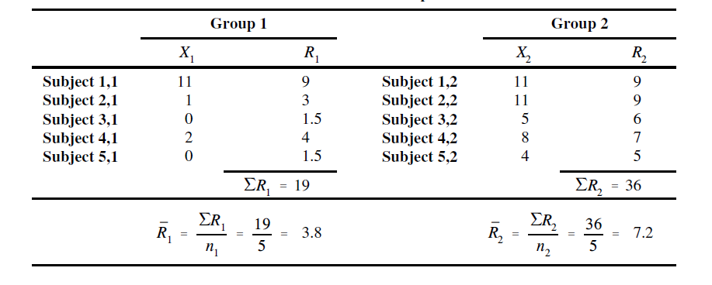
The total number of subjects employed in the experiment is N = 10. There are subjects in Group 1 and subjects in Group 2.

Slide 121
All N = 10 scores are arranged in order of magnitude (irrespective of group membership), beginning on the left with the lowest score and moving to the right as scores increase. This is done in the second row of the table.
In the third row of the table, all N = 10 scores are assigned a rank. Moving from left to right, a rank of 1 is assigned to the score that is furthest to the left (which is the lowest score), a rank of 2 is assigned to the score that is second from the left (which, if there are no ties, will be the second lowest score), and so on until the score at the extreme right (which will be the highest score) is assigned a rank equal to N (if there are no ties for the highest score).
The ranks in the third row must be adjusted when there are tied scores present in the data. Specifically, in instances where two or more subjects have the same score, the average of the ranks involved is assigned to all scores tied for a given rank. This adjustment is made in the fourth row.

Slide 122
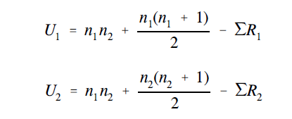
It should be noted that it is permissible to reverse the ranking protocol described in this section. Specifically, one can assign a rank of 1 to the highest score, a rank of 2 to the second highest score, and so on, until reaching the lowest score which is assigned a rank equal to the value of N.
Once all of the subjects have been assigned a rank, the sum of the ranks for each of the
groups is computed. These values, ∑R₁ = 19 si ∑R₂ = 36 . Upon determining the sum of the
ranks for both groups, the values U₁ and U₂ are computed:

Slide 123
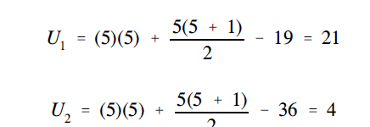
Note that U₁ and U₂ and can never be negative values. If a negative value is obtained for either, it indicates an error has been made in the rankings and/or calculations.
Verify:

Slide 124
Interpretation of the Test Results:
The smaller of the two values that U₁ versus U₂ is designated as the obtained U statistic. Since U₂ =4 is smaller than U₁ =21 , the value of U = 4.
For n₁=5 and n₂=5, the tabled critical two-tailed .05 and .01 values are U_{.05} =2 and U_{.01} =0, and the tabled critical one-tailed .05 and .01 values are U_{.05} =4 and U_{.01} =1. In order to be significant, the obtained value of U must be equal to or less than the tabled critical value at the prespecified level of significance.
Since the obtained value U = 4 must be equal to or less than the aforementioned tabled critical values, the null hypothesis can only be rejected if the directional alternative hypothesis H₁: θ₁< θ₂ is employed.
The directional H₁: θ₁< θ₂ alternative hypothesis is supported at the .05 level, since U = 4 is equal to the tabled critical one-tailed value U_{.05} =4 . The data are consistent with the directional alternative hypothesis H₁: θ₁< θ₂ , since the average of the ranks in Group 1 is less than the average of the ranks in Group 2 .
Conclusion: the null hypothesis can only be rejected if the researcher employs a directional alternative hypothesis that predicts a lower degree of depression in the group that receives the antidepressant medication (Group 1).

Slide 125
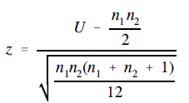
The normal approximation of the Mann–Whitney U statistic for large sample sizes -
If the sample size employed in a study is relatively large, the normal distribution can be employed to approximate the Mann–Whitney U statistic. Although sources do not agree on the value of the sample size that justifies employing the normal approximation of the Mann–Whitney distribution, they generally state that it should be employed for sample sizes larger than those documented in the exact table of the U distribution contained within the source.
The normal approximation of the Mann–Whitney U test statistic is
Although Example 7.1 involves only N = 10 scores (a value most sources would view as too small to use with the normal approximation), it will be employed to illustrate the equation.
It can be seen that in spite of employing this equation with a small sample size, it yields a result that is consistent with the result obtained when the exact table for the Mann–Whitney U distribution is employed. It should be noted that since the smaller of the two values U₁ versus U₂ is selected to represent U, the value of z will always be negative (unless U₁= U₂)in which case z = 0). This is the case, since by selecting the smaller value U will always be less than the expected value U_{E} = n₁ n₁/2

Slide 126
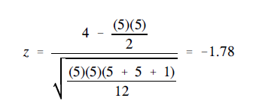
The obtained value z = –1.78 is evaluated with the Table of the Normal Distribution . In order to be significant, the obtained absolute value of z must be equal to or greater than the tabled critical value at the prespecified level of significance. The tabled critical two-tailed .05 and .01 values are z_{.05}=1.96 and z_{.01}=2.58 , and the tabled critical one-tailed .05 and .01 values are z_{.05}=1.65 and z_{.01}=2.33 . The following guidelines are employed in evaluating the null hypothesis.
a) If the nondirectional alternative hypothesis is employed, the null hypothesis can be rejected if the obtained absolute value of z is equal to or greater than the tabled critical two-tailed value at the prespecified level of significance.
b) If a directional alternative hypothesis is employed, one of the two possible directional alternative hypotheses is supported if the obtained absolute value of z is equal to or greater than the tabled critical one-tailed value at the prespecified level of significance. The directional alternative hypothesis that is supported is the one that is consistent with the data.

Slide 127
Conclusion: Since the obtained absolute value z = 1.78 must be equal to or greater than the tabled critical value at the prespecified level of significance, the null hypothesis can only be rejected if the directional alternative hypothesis H₁: θ₁< θ₂ is employed
The directional alternative hypothesis H₁: θ₁< θ₂ is supported at the .05 level, since the absolute value z = 1.78 is greater than the tabled critical one-tailed value z_{.05}=1.65.
It turns out that the above conclusions based on the normal approximation are identical to those reached when the exact table of the Mann–Whitney U distribution is employed.

Slide 128
R code
# independent 2-group Mann-Whitney U Test
x<-c(11, 1, 0, 2, 0)
y<-c(11, 11, 5, 8, 4)
wilcox.test(x,y)
Wilcoxon rank sum test with continuity correction
data: x and y
W = 4, p-value = 0.08969
alternative hypothesis: true location shift is not equal to 0

Slide 129
R code
# independent 2-group Mann-Whitney U Test
# where a is numeric and f is abinary factor
a<-c(11, 1, 0, 2, 0,11, 11, 5, 8, 4)
f<-c(1,1,1,1,1,2,2,2,2,2)
wilcox.test(a~f)
Wilcoxon rank sum test with continuity correction
data: a by f
W = 4, p-value = 0.08969
alternative hypothesis: true location shift is not equal to 0

Slide 130
R code
# independent 2-group Mann-Whitney U Test
# where a is numeric and f is a binary factor
a<-c(11, 1, 0, 2, 0,11, 11, 5, 8, 4)
f<-c(1,1,1,1,1,2,2,2,2,2)
wilcox.test(a~f)
Wilcoxon rank sum test with continuity correction
data: a by f
W = 4, p-value = 0.08969
alternative hypothesis: true location shift is not equal to 0

Slide 131
Example 7.2 Doctor Radical, a math instructor at Logarithm University, has two classes in advanced calculus. There are six students in Class 1 and seven students in Class 2. The instructor uses a programmed textbook in Class 1 and a conventional textbook in Class 2. At the end of the semester, in order to determine if the type of text employed influences student performance, Dr. Radical has another math instructor, Dr. Root, rank the 13 students in the two classes with respect to math ability. The rankings of the students in the two classes follow: Class 1: 1, 3, 5, 7, 11, 13; Class 2: 2, 4, 6, 8, 9, 10, 12 (assume the lower the rank the better the student).

Slide 132
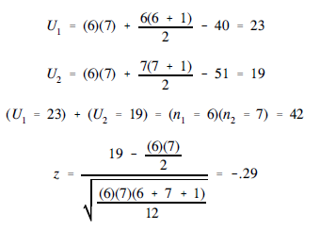

Slide 133
Endnotes:
Note of the following with respect to the table of critical values for the Mann–Whitney U distribution:
No critical values are recorded in the Mann–Whitney table for very small sample sizes, since a level of significance of .05 or less cannot be achieved for sample sizes below a specific minimum value;
b) The critical values published in Mann–Whitney tables by various sources may not be identical. Such differences are trivial (usually one unit)

Slide 134
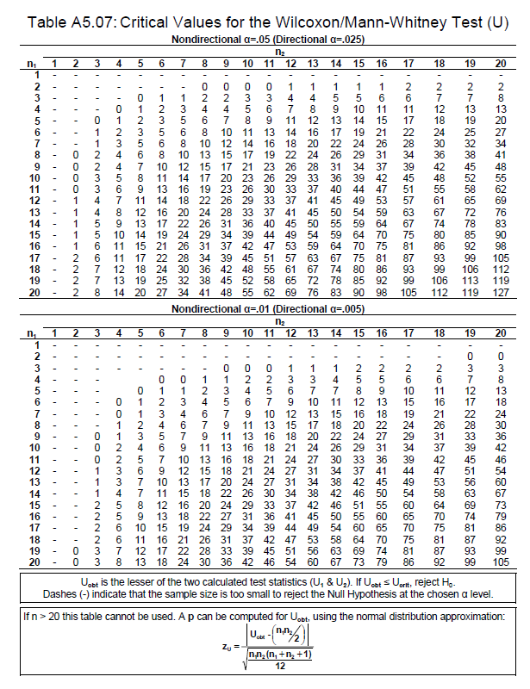

Slide 135
8. The Wilcoxon Matched-Pairs Signed-Ranks Test (Nonparametric Test Employed with Ordinal Data)
Hypothesis evaluated with test Do two dependent samples represent two different populations?
Relevant background information on test The Wilcoxon matched-pairs signed-ranks test (Wilcoxon (1945, 1949)) is a nonparametric procedure employed in a hypothesis testing situation involving a design with two dependent samples. Whenever one or more of the assumptions of the t test for two dependent samples are saliently violated, the Wilcoxon matched-pairs signed-ranks test (which has less stringent assumptions) may be preferred as an alternative procedure.

Slide 136
8. The Wilcoxon Matched-Pairs Signed-Ranks Test (Nonparametric Test Employed with Ordinal Data)
The Wilcoxon matched-pairs signed-ranks test is essentially an extension of the Wilcoxon signed-ranks test (which is employed for a single sample design) to a design involving two dependent samples.
In order to employ the Wilcoxon matched-pairs signed ranks test, it is required that each of n subjects (or n pairs of matched subjects) has two interval/ratio scores (each score having been obtained under one of the two experimental conditions). A difference score is computed for each subject (or pair of matched subjects) by subtracting a subject’s score in Condition 2 from his score in Condition 1.
The hypothesis evaluated with the Wilcoxon matched-pairs signed-ranks test is whether or not in the underlying populations represented by the samples/experimental conditions, the median of the difference scores equals zero.

Slide 137
8. The Wilcoxon Matched-Pairs Signed-Ranks Test (Nonparametric Test Employed with Ordinal Data)
If a significant difference is obtained, it indicates there is a high likelihood the two samples/conditions represent two different populations.
The Wilcoxon matched-pairs signed-ranks test is based on the following assumptions:
The sample of n subjects has been randomly selected from the population it represents;
The original scores obtained for each of the subjects are in the format of interval/ratio data; and
The distribution of the difference scores in the populations represented by the two samples is symmetric about the median of the population of difference scores.

Slide 138
8. The Wilcoxon Matched-Pairs Signed-Ranks Test (Nonparametric Test Employed with Ordinal Data)
As is the case for the t test for two dependent samples, in order for the Wilcoxon matched-pairs signed-ranks test to generate valid results, the following guidelines should be adhered to:
a) To control for order effects, the presentation of the two experimental conditions should be random or, if appropriate, be counterbalanced; and b) If matched samples are employed, within each pair of matched subjects each of the subjects should be randomly assigned to one of the two experimental conditions
As is the case with the t test for two dependent samples, the Wilcoxon matched-pairs signed-ranks test can also be employed to evaluate a before-after design.

Slide 139
8. The Wilcoxon Matched-Pairs Signed-Ranks Test (Nonparametric Test Employed with Ordinal Data)
The Wilcoxon matched-pairs signed-ranks test, does not rank the original interval/ratio scores, but instead ranks the interval/ratio difference scores of subjects (or matched pairs of subjects).
For this reason, some sources categorize the Wilcoxon matched-pairs signed-ranks test as a test of interval/ratio data. Most sources, however categorize the Wilcoxon matched-pairs signed-ranks test as a test of ordinal data, by virtue of the fact that a ranking procedure is part of the test protocol.

Slide 140
Example 8.1 A psychologist conducts a study to determine whether or not people exhibit more emotionality when they are exposed to sexually explicit words than when they are exposed to neutral words. Each of ten subjects is shown a list of 16 randomly arranged words, which are projected onto a screen one at a time for a period of five seconds. Eight of the words on the list are sexually explicit and eight of the words are neutral. As each word is projected on the screen, a subject is instructed to say the word softly to him or herself. As a subject does this, sensors attached to the palms of the subject’s hands record galvanic skin response (GSR), which is used by the psychologist as a measure of emotionality.
The psychologist computes two scores for each subject, one score for each of the experimental conditions: Condition 1: GSR/Explicit — The average GSR score for the eight sexually explicit words; Condition 2: GSR/Neutral — The average GSR score for the eight neutral words.
The GSR/Explicit and the GSR/Neutral scores of the ten subjects follow. (The higher the score, the higher the level of emotionality.) Subject 1 (9, 8); Subject 2 (2, 2); Subject 3 (1, 3); Subject 4 (4, 2); Subject 5 (6, 3); Subject 6 (4, 0); Subject 7 (7, 4); Subject 8 (8, 5); Subject 9 (5, 4); Subject 10 (1, 0).
Do subjects exhibit differences in emotionality with respect to the two categories of words?

Slide 141
Null hypothesis: H₀: θ_{D}=0
(In the underlying populations represented by Condition 1 and Condition 2, the median of the difference scores equals zero. With respect to the sample data, this translates into the sum of the ranks of the positive difference scores being equal to the sum of the ranks of the negative difference scores (i.e., ∑R+ = ∑R–).
Alternative hypothesis : H₀: θ_{D}≠0
(In the underlying populations represented by Condition 1 and Condition 2, the median of the difference scores is some value other than zero. With respect to the sample data, this translates into the sum of the ranks of the positive difference scores not being equal to the sum of the ranks of the negative difference scores (i.e., ∑R+ ≠ ∑R–).
This is a nondirectional alternative hypothesis and it is evaluated with a two-tailed test.)

Slide 142
Alternative hypothesis : H₀: θ_{D}>0
(In the underlying populations represented by Condition 1 and Condition 2, the median of the difference scores is some value that is greater than zero. With respect to the sample data, this translates into the sum of the ranks of the positive difference scores being greater than the sum of the ranks of the negative difference scores (i.e., ∑R+ > ∑R–). The latter result indicates that the scores in Condition 1 are higher than the scores in Condition 2.
This is a directional alternative hypothesis and it is evaluated with a one-tailed test.)
Alternative hypothesis : H₀: θ_{D}<0
(In the underlying populations represented by Condition 1 and Condition 2, the median of the difference scores is some value that is less than zero (i.e., a negative number). With respect to the sample data, this translates into the sum of the ranks of the positive difference scores being less than the sum of the ranks of the negative difference scores (i.e., ∑R+ < ∑R–). The latter result indicates that the scores in Condition 2 are higher than the scores in Condition 1.
This is a directional alternative hypothesis and it is evaluated with a one-tailed test.)

Slide 143
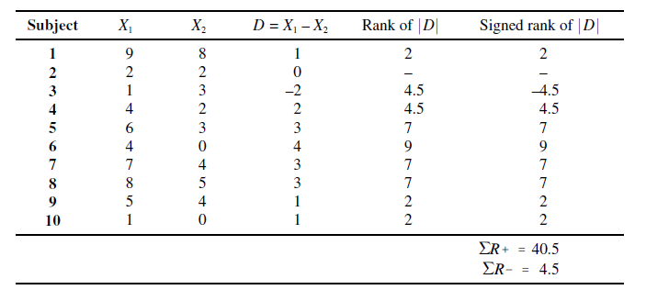
X₁ represents each subject’s score in Condition 1 (sexually explicit words) and X₂ represents each subject’s score in Condition 2 (neutral words).
D score is computed for each subject by subtracting a subject’s score in Condition 2 from the subject’s score in Condition 1, D= X₁ - X₂
D scores have been ranked with respect to their absolute values

Slide 144
a) The absolute values of the difference scores (|D|) are ranked (i.e., the sign of a difference score is not taken into account).
b) Any difference score that equals zero is not ranked. This translates into eliminating from the analysis any subject who yields a difference score of zero.
c) When there are tied scores present in the data, the average of the ranks involved is assigned to all scores tied for a given rank.
d) As is the case with the Wilcoxon signed-ranks test, when ranking difference scores for the Wilcoxon matched-pairs signed-ranks test it is essential that a rank of 1 be assigned to the difference score with the lowest absolute value, and that a rank of n be assigned to the difference score with the highest absolute value (where n represents the number of signed ranks — i.e., difference scores that have been ranked).

Slide 145
Upon ranking the absolute values of the difference scores, the sign of each difference score is placed in front of its rank
Note that although 10 subjects participated in the experiment there are only n = 9 signed ranks, since Subject 2 had a difference score of zero which was not ranked.
The sum of the ranks that have a positive sign (i.e., ∑R+ = 40.5) and the sum of the ranks that have a negative sign (i.e., ∑R– = 4.5) are recorded at the bottom of Column 6
The following equation allows one to check the accuracy of these values

Slide 146
Interpretation of the Test Results
If the sample is derived from a population in which the median of the difference scores equals zero, the values of ∑R+ and ∑R– will be equal to one another.
When ∑R+ and ∑R– are equivalent, both of these values will equal [n(n + 1)]/4, which in the case of
Example 8.1 will be [(9)(10)]/4 = 22.5. This latter value is commonly referred to as the expected value of the Wilcoxon T statistic
If the value of ∑R+ is significantly greater than the value of ∑R– it indicates there is a high likelihood that Condition 1 represents a population with higher scores than the population represented by Condition 2.
On the other hand, if ∑R– is significantly greater than ∑R+ it indicates there is a high likelihood that Condition 2 represents a population with higher scores than the population represented by Condition 1.
Since ∑R+ = 40.5 is greater than ∑R– = 4.5, and thus the data are consistent with the directional alternative hypothesis (i.e., it indicates that subjects obtained higher scores in Condition 1 than Condition 2). The question is, however, whether the difference is significant — i.e., whether it is large enough to conclude that it is unlikely to be the result of chance.

Slide 147
The absolute value of the smaller of the two values ∑R+ versus ∑R– is designated as the Wilcoxon T test statistic. Since ∑R– = 4.5 is smaller than ∑R+ = 40.5, T = 4.5. The T value is interpreted by employing Table A5 (Table of Critical T Values for Wilcoxon’s Signed- Ranks and Matched-Pairs Signed-Ranks Tests)
In order to be significant, the obtained value of T must be equal to or less than the tabled critical T value at the prespecified level of significance.
Since the null hypothesis can only be rejected if the computed value T = 4.5 is equal to or less than the tabled critical value at the prespecified level of significance, we can conclude the following:

Slide 148
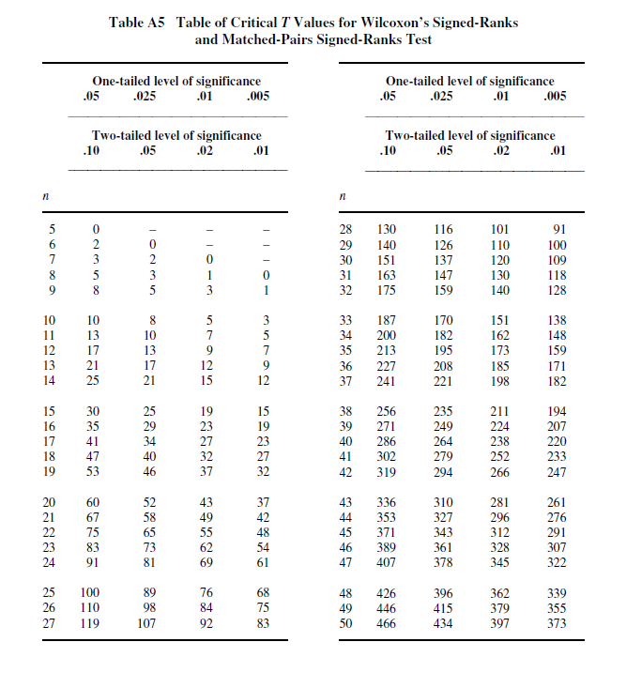

Slide 150
CONCLUSION
It can be concluded that subjects exhibited higher GSR (emotionality) scores with respect to the sexually explicit words than the neutral words.
The directional alternative hypothesis H₀: θ_{D}>0 is only supported at the .05 level

Slide 151
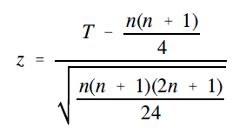
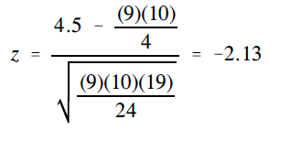
The normal approximation of the Wilcoxon T statistic for large sample sizes As is the case with the Wilcoxon signed-ranks test, if the sample size employed in a study is relatively large, the normal distribution can be employed to approximate the Wilcoxon T statistic.
Although sources do not agree on the value of the sample size that justifies employing the normal approximation of the Wilcoxon distribution, they generally state that it should be employed for sample sizes larger than those documented in the Wilcoxon table contained within the source.
The following equation provides the normal approximation for Wilcoxon T. In the equation T represents the computed value of Wilcoxon T, which for Example 8.1 is T = 4.5. n, as noted previously, represents the number of signed ranks. Thus, in our example, n = 9.

Slide 152
The obtained value z = –2.13 is evaluated with the Table of the Normal Distribution. The tabled critical two-tailed .05 and .01 values are z_{.05}=1.96 and z_{.01}=2.58 , and the tabled critical one-tailed .05 and .01 values are z_{.05}=1.65 and z_{.01}=2.33 . The following guidelines are employed in evaluating the null hypothesis.
Since the smaller of the two values ∑R+ and ∑R– is selected to represent T, the value of z computed above will always be negative unless ∑R+ = ∑R–, in which case z will be zero.
Guidelines:
If a nondirectional alternative hypothesis is employed, the null hypothesis can be rejected if the obtained absolute value of z is equal to or greater than the tabled critical two-tailed value at the prespecified level of significance
b) When a directional alternative hypothesis is employed, one of the two possible directional alternative hypotheses will be supported if the obtained absolute value of z is equal to or greater than the tabled critical one-tailed value at the prespecified level of significance.
Which alternative hypothesis is supported depends on the prediction regarding which of the two values ∑R+ versus ∑R– is larger. The null hypothesis can only be rejected if the directional alternative hypothesis that is consistent with the data is supported.

Slide 153
CONCLUSION
The directional alternative hypothesis H₀: θ_{D}>0 is supported at the .05 level
This decision is consistent with the decision that is reached when the exact table of the Wilcoxon distribution is employed to evaluate the directional alternative hypothesis H₀: θ_{D}>0.

Slide 154
R code
# dependent 2-group Mann-Whitney U Test
y1<-c(9,2,1,4,6,4,7,8,5,1)
y2<-c(8,2,3,2,3,0,4,5,4,0)
wilcox.test(y2,y1,paired=TRUE)
Wilcoxon signed rank test with continuity correction
data: y2 and y1
V = 4.5, p-value = 0.03664
alternative hypothesis: true location shift is not equal to 0

Slide 155
9. The Binomial Sign Test for Two Dependent Samples (Nonparametric Test Employed with Ordinal Data)
Hypothesis evaluated with test Do two dependent samples represent two different populations?
The binomial sign test for two dependent samples is based on the following assumptions:
The sample of n subjects has been randomly selected from the population it represents;
The format of the data is such that within each pair of scores the two scores can be rank-ordered.

Slide 156
Example 8.1 A psychologist conducts a study to determine whether or not people exhibit more emotionality when they are exposed to sexually explicit words than when they are exposed to neutral words. Each of ten subjects is shown a list of 16 randomly arranged words, which are projected onto a screen one at a time for a period of five seconds. Eight of the words on the list are sexually explicit and eight of the words are neutral. As each word is projected on the screen, a subject is instructed to say the word softly to him or herself. As a subject does this, sensors attached to the palms of the subject’s hands record galvanic skin response (GSR), which is used by the psychologist as a measure of emotionality.
The psychologist computes two scores for each subject, one score for each of the experimental conditions: Condition 1: GSR/Explicit — The average GSR score for the eight sexually explicit words; Condition 2: GSR/Neutral — The average GSR score for the eight neutral words.
The GSR/Explicit and the GSR/Neutral scores of the ten subjects follow. (The higher the score, the higher the level of emotionality.) Subject 1 (9, 8); Subject 2 (2, 2); Subject 3 (1, 3); Subject 4 (4, 2); Subject 5 (6, 3); Subject 6 (4, 0); Subject 7 (7, 4); Subject 8 (8, 5); Subject 9 (5, 4); Subject 10 (1, 0).
Do subjects exhibit differences in emotionality with respect to the two categories of words?

Slide 157
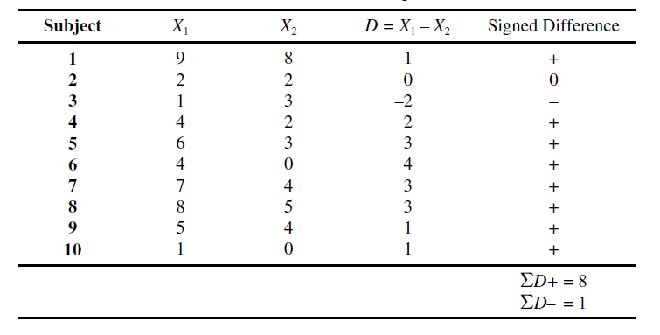
The following information can be derived from Table:
Eight subjects (Subjects 1, 4, 5, 6, 7, 8, 9, 10) yield a difference score with a positive sign — i.e., a positive signed difference;
One subject (Subject 3) yields a difference score with a negative sign — i.e., a negative signed difference; and
One subject (Subject 2) obtains the identical score in both conditions, and as a result of this yields a difference score of zero.
Any subject who obtains a zero difference score is eliminated from the data analysis. Since Subject 2 falls in this category, the size of the sample is reduced to n = 9.

Slide 158
The logic underlying the binomial sign test for two dependent samples is that if the two experimental conditions represent equivalent populations, the signed differences should be randomly distributed.
Thus, assuming that subjects who obtain a difference score of zero are eliminated from the analysis, if the remaining signed differences are, in fact, randomly distributed, one-half of the subjects should obtain a positive signed difference and one-half of the subjects should obtain a negative signed difference.
The observed proportion of positive signed differences is p+ = 8/9 = .89 and the observed proportion of negative signed differences is p– = 1/9 = .11.
The nondirectional alternative hypothesis π+≠ .05 is supported at the α=.05 level, since the obtained probability .0195 is less than α/2 = .05/2 = .025.
The directional alternative hypothesis π+> .05 is supported at the α=.05 level.
It can be concluded that subjects exhibited higher GSR (emotionality) scores with respect to the sexually explicit words than the neutral words.

Slide 159
When the binomial sign test for two dependent samples and the Wilcoxon matched pairs signed-ranks test are applied to the same set of data, the two tests yield identical conclusions.
When applied to the same data the binomial sign test for two dependent samples tends to be less powerful than the Wilcoxon matched-pairs signed-ranks test.
This is the case, since by not considering the magnitude of the difference scores, the binomial sign test for two dependent samples employs less information than the Wilcoxon matched-pairs signed-ranks test.

Slide 160
TWO OR MORE INDEPENDENT SAMPLES

Slide 161
10. The Kruskal–Wallis One-Way Analysis of Variance by Ranks (Nonparametric Test Employed with Ordinal Data)
Hypothesis evaluated with test In a set of k independent samples (where k 2), do at least two of the samples represent populations with different median values?
Relevant background information on test The Kruskal–Wallis one-way analysis of variance by ranks (Kruskal (1952) and Kruskal and Wallis (1952)) is employed with ordinal (rankorder) data in a hypothesis testing situation involving a design with two or more independent samples. The test is an extension of the Mann–Whitney U test to a design involving more than two independent samples and, when k = 2, the Kruskal–Wallis one-way analysis of variance by ranks will yield a result that is equivalent to that obtained with the Mann–Whitney U test.
If the result of the Kruskal–Wallis one-way analysis of variance by ranks is significant, it indicates there is a significant difference between at least two of the sample medians in the set of k medians. As a result of the latter, the researcher can conclude there is a high likelihood that at least two of the samples represent populations with different median values

Slide 162
10. The Kruskal–Wallis One-Way Analysis of Variance by Ranks (Nonparametric Test Employed with Ordinal Data)
In employing the Kruskal–Wallis one-way analysis of variance by ranks one of the following is true with regard to the rank-order data that are evaluated:
The data are in a rank order format, since it is the only format in which scores are available; or
The data have been transformed into a rank-order format from an interval/ratio format, since the researcher has reason to believe that one or more of the assumptions of the single-factor between-subjects analysis of variance are violated.
It should be noted that when a researcher elects to transform a set of interval/ratio data into ranks, information is sacrificed.

Slide 163
10. The Kruskal–Wallis One-Way Analysis of Variance by Ranks (Nonparametric Test Employed with Ordinal Data)
Various sources (e.g., Conover (1980, 1999), Daniel (1990), and Marascuilo and McSweeney (1977)) note that the Kruskal–Wallis one-way analysis of variance by ranks is based on the following assumptions:
Each sample has been randomly selected from the population it represents;
The k samples are independent of one another;
The dependent variable (which is subsequently ranked) is a continuous random variable. In truth, this assumption, which is common to many nonparametric tests, is often not adhered to, in that such tests are often employed with a dependent variable that represents a discrete random variable; and
The underlying distributions from which the samples are derived are identical in shape.
The shapes of the underlying population distributions, however, do not have to be normal.

Slide 164
Example 10.1 A psychologist conducts a study to determine whether or not noise can inhibit learning. Each of 15 subjects is randomly assigned to one of three groups. Each subject is given 20 minutes to memorize a list of 10 nonsense syllables which she is told she will be tested on the following day.
The five subjects assigned to Group 1, the no noise condition, study the list of nonsense syllables while they are in a quiet room. The five subjects assigned to Group 2, the moderate noise condition, study the list of nonsense syllables while listening to classical music.
The five subjects assigned to Group 3, the extreme noise condition, study the list of nonsense syllables while listening to rock music. The number of nonsense syllables correctly recalled by the 15 subjects follows: Group 1: 8, 10, 9, 10, 9; Group 2: 7, 8, 5, 8, 5; Group 3: 4, 8, 7, 5, 7. Do the data indicate that noise influenced subjects’ performance?

Slide 165
Null hypothesis H₀:θ₁= θ₂= θ₃
(The median of the population Group 1 represents equals the median of the population Group 2 represents equals the median of the population Group 3 represents. With respect to the sample data, when there are an equal number of subjects in each group, the sums of the ranks will be equal for all k groups — i.e.,∑R₁ = ∑R₂ = ∑R₃).
Alternative hypothesis H₁: Not H₀
(This indicates that there is a difference between at least two of the k = 3 population medians.
With respect to the sample data, if there are an equal number of subjects in each group, when the alternative hypothesis is true the sums of the ranks of at least two of the k groups will not be equal.)

Slide 166
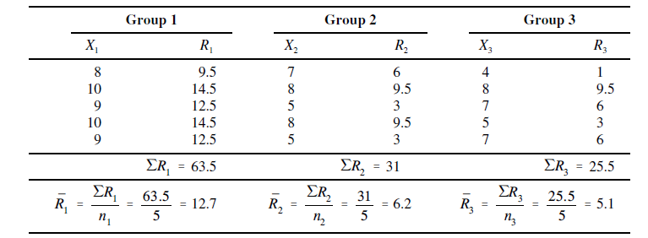
The total number of subjects employed in the experiment is N = 15. There are n_{j =} n₁ ₌ n₂ ₌ n₃ =5 subjects in each group.

Slide 167
a) All N = 15 scores are arranged in order of magnitude (irrespective of group membership), beginning on the left with the lowest score and moving to the right as scores increase. This is done in the second row.
b) In the third row, all N = 15 scores are assigned a rank. Moving from left to right, a rank of 1 is assigned to the score that is furthest to the left (which is the lowest score), a rank of 2 is assigned to the score that is second from the left (which, if there are no ties, will be the second lowest score), and so on until the score at the extreme right (which will be the highest score) is assigned a rank equal to N (if there are no ties for the highest score).
c) In instances where two or more subjects have the same score, the average of the ranks involved is assigned to all scores tied for a given rank. The tie-adjusted ranks are listed in the fourth row.
Upon rank-ordering the scores of the N = 15 subjects, the sum of the ranks is computed for each group, ∑R₁ =63.5, ∑R₂ =31, ∑R₃=25.5.
The chi-square distribution is used to approximate the Kruskal–Wallis test statistic.

Slide 168
Note that indicates that for each of the k groups, the sum of the ranks is squared and then divided by the number of subjects in the group. Upon doing this for all k groups, the resulting values are summed. Substituting the appropriate values the value H = 8.44 is computed.

Slide 169
Interpretation of the Test Results
In order to reject the null hypothesis, the computed value H=X² must be equal to or greater than the tabled critical chi-square value at the prespecified level of significance.
The number of degrees of freedom are df = 3 – 1 = 2.
For df = 2, the tabled critical .05 and .01 chi-square values are X²_{.05}=5.99 and X²_{.01}=9.21. Since the computed value H = 8.44 is greater than X²_{.05}=5.99, the alternative hypothesis is supported at the .05 level.
It can be concluded that there is a significant difference between at least two of the three groups exposed to different levels of noise. This result can be summarized as follows: H(2) = 8.44, p < .05.

Slide 170
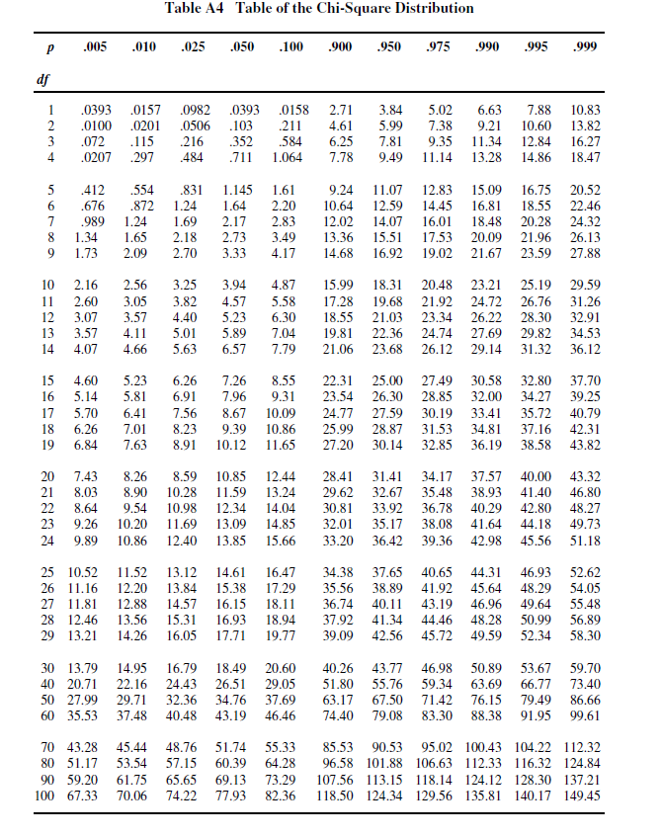

Slide 171
Tie correction for the Kruskal–Wallis one-way analysis of variance by ranks Some sources recommend that if there is an excessive number of ties in the overall distribution of N scores, the value of the Kruskal–Wallis test statistic be adjusted. The tie correction results in a small increase in the value of H (thus providing a slightly more powerful test of the alternative hypothesis).
Compute the value C, which represents the tie correction factor for the Kruskal–Wallis one-way analysis of variance by ranks.

Slide 172
The notation indicates the following:
a) For each set of ties, the number of ties in the set is subtracted from the cube of the number of ties in that set; and
b) The sum of all the values computed in part a) is obtained.
H_{c} represents the tie-corrected value of the Kruskal–Wallis test statistic.
The value H_{c} = 8.76 is significant at the .05 level (is greater than X²_{.05}=5.99).

Slide 173
Pairwise comparisons following computation of the test statistic for the Kruskal–Wallis one-way analysis of variance by ranks
The H value computed above is based on an evaluation of all k groups. When the value of H is significant, it does not indicate whether just two or, in fact, more than two groups differ significantly from one another. In order to answer the latter question, it is necessary to conduct comparisons contrasting specific groups with one another.
In conducting a simple comparison, the null hypothesis and nondirectional alternative hypothesis are as follows:
H₀: θ_{a}= θ_{b} versus
H₁: θ_{a}≠ θ_{b}.
In the aforementioned hypotheses, θ_{a}= θ_{b} represent the medians of the populations represented by the two groups involved in the comparison.

Slide 174
Pairwise comparisons following computation of the test statistic for the Kruskal–Wallis one-way analysis of variance by ranks
Various sources (e.g., Daniel (1990) and Siegel and Castellan (1988)) describe a comparison procedure for the Kruskal–Wallis one-way analysis of variance by ranks (described by Dunn (1964)), which is essentially the application of the Bonferroni–Dunn method.
First formally described by Dunn (1961), the Bonferroni–Dunn test is based on the Bonferroni inequality, which states that the probability of the occurrence of a set of events can never be greater than the sum of the individual probabilities for each event.
In actuality, the Bonferroni–Dunn test is computationally identical to multiple t tests.
The Bonferroni–Dunn test requires a researcher to initially stipulate the highest familywise Type I error rate he is willing to tolerate

Slide 175
Pairwise comparisons following computation of the test statistic for the Kruskal–Wallis one-way analysis of variance by ranks
Example. If the researcher does not want the value of to exceed .05 (i.e., he does not want more than a 5% chance of committing at least one Type I error in a set of comparisons).
To insure that the family wise Type I error rate does not exceed .05, .05 is divided by c = 3, which represents the number of comparisons that comprise the set. The resulting value .05/3 = .0167 represents for each of the comparisons that are conducted, the likelihood of committing a Type I error.

Slide 176
Pairwise comparisons following computation of the test statistic for the Kruskal–Wallis one-way analysis of variance by ranks
Through use of the following equation, the procedure allows a researcher to identify the minimum required difference between the means of the ranks of any two groups (designated as ) in order for them to differ from one another at the prespecified level of significance.
The value of is obtained from theTable of the Normal Distribution). In the case of a nondirectional alternative hypothesis, z_{adj} is the value above which a proportion of cases corresponding to the value α_{FW}/2c falls (where c is the total number of comparisons that are conducted).

Slide 177
Pairwise comparisons following computation of the test statistic for the Kruskal–Wallis one-way analysis of variance by ranks
When all possible pairwise comparisons are made c = [k(k – 1)]/2, and thus, 2c = k(k – 1).
In Example 10.1 the number of pairwise/simple comparisons that can be conducted are c = [3(3 – 1)]/2 = 3 — specifically, Group 1 versus Group 2, Group 1 versus Group 3, and Group 2 versus Group 3.
The value of z_{adj} will be a function of both the maximum familywise Type I error rate (α_{FW}) the researcher is willing to tolerate and the total number of comparisons that are conducted.
Thus, if a nondirectional alternative hypothesis is employed and α =α_{FW}=.05 , the tabled critical two-tailed .05 value z_{.05} =1.96 is used to represent z_{adj} in the previous Equation.

Slide 178
Pairwise comparisons following computation of the test statistic for the Kruskal–Wallis one-way analysis of variance by ranks
Thus, in Example 10.1, if one intends to conduct all three pairwise comparisons and wants to insure that α_{FW} does not exceed .05, α_{PC} =α_{FW} /c=.05/3=.0167 . The latter proportion is used to determine the value of z_{adj} .
The z value that corresponds to the proportion .0167 is z = 2.13.
By employing z_{adj} =2.13 in the equation, one can be assured that within the “family” of three pairwise comparisons, will not exceed .05 (assuming all of the comparisons are directional).

Slide 179
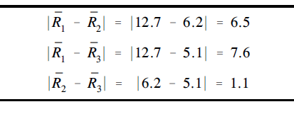
Pairwise comparisons following computation of the test statistic for the Kruskal–Wallis one-way analysis of variance by ranks
Thus

Slide 180
Example 10.2 Doctor Radical, a math instructor at Logarithm University, has three classes in advanced calculus. There are five students in each class. The instructor uses a programmed textbook in Class 1, a conventional textbook in Class 2, and his own printed notes in Class 3. At the end of the semester, in order to determine if the type of instruction employed influences student performance, Dr. Radical has another math instructor, Dr. Root, rank the 15 students in the three classes with respect to math ability. The rankings of the students in the three classes follow: Class 1: 9.5, 14.5, 12.5, 14.5, 12.5; Class 2: 6, 9.5, 3, 9.5, 3; and Class 3: 1, 9.5, 6, 3, 6 (assume the lower the rank, the better the student).

Slide 181
Example 10.3 Doctor Radical, a math instructor at Logarithm University, has four classes in advanced calculus. There are six students in Class 1, seven students in Class 2, eight students in Class 3, and six students in Class 4. The instructor uses a programmed textbook in Class 1, a conventional textbook in Class 2, his own printed notes in Class 3, and no written instructional material in Class 4. At the end of the semester, in order to determine if the type of instruction employed influences student performance, Dr. Radical has another math instructor, Dr. Root, rank the 27 students in the four classes with respect to math ability. The rankings of the students in the four classes follow: Class 1: 1, 2, 4, 6, 8, 9; Class 2: 10, 14, 18, 20, 21, 25, 26; Class 3: 3, 5, 7, 11, 12 16, 17, 22; Class 4: 13, 15, 19, 23, 24, 27 (assume the lower the rank, the better the student).

Slide 182
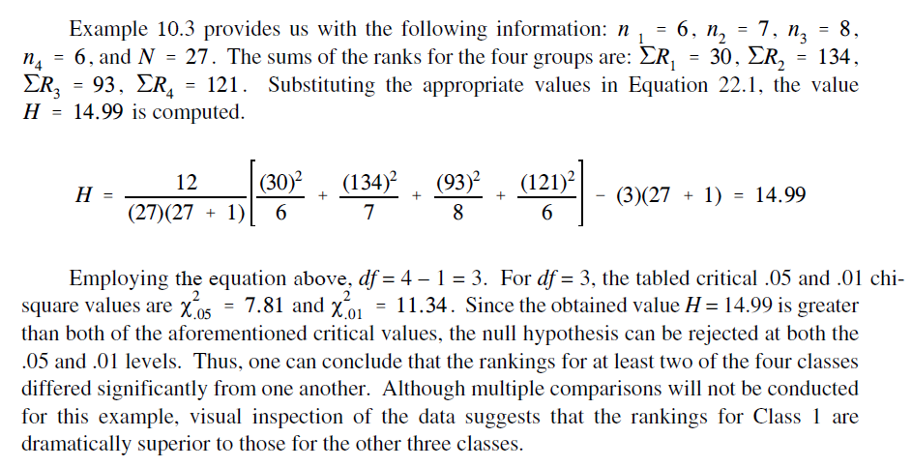

Slide 183
R code
# Kruskal Wallis
group<-c(1,1,1,1,1,2,2,2,2,2,3,3,3,3,3)
syllables<-c(8, 10, 9, 10, 9,7, 8, 5, 8, 5,4, 8, 7, 5, 7)
kruskal.test(syllables ~group)
Kruskal-Wallis rank sum test
data: syllables by group
Kruskal-Wallis chi-squared = 8.7474, df = 2, p-value = 0.0126
library(PMCMRplus)
posthoc.kruskal.dunn.test(x=syllables, g=group, p.adjust.method="bonferroni")
Pairwise comparisons using Dunn's-test for multiple
comparisons of independent samples
data: syllables and group
1 2
2 0.058 –
3 0.019 1.000
P value adjustment method: bonferroni Warning message: In posthoc.kruskal.dunn.test.default(x = syllables, g = group, p.adjust.method = "bonferroni") : Ties are present. z-quantiles were corrected for ties.
pairwise.wilcox.test(syllables, group,p.adj='bonferroni',exact=F)
Pairwise comparisons using Wilcoxon rank sum test
data: syllables and group
1 2
2 0.057 -
3 0.045 1.000
P value adjustment method: bonferroni

Slide 184
If ranking of values results in any ties, a tie correction is required. In that case, find a new H statistic by dividing the original H statistic by the tie correction. Use formula below to determine the tie correction value;
where C_{H} is the ties correction, T is the number of values from a set of ties, and N is the number of values from all combined samples.
If the H statistic is not significant, then no differences exist between any of the samples. However, if the H statistic is significant, then a difference exists between at least two of the samples.

Slide 185
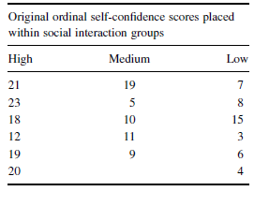
Example. Researchers were interested in studying the social interaction of different adults. They sought to determine if social interaction can be tied to self-confidence. The researchers classified 17 participants into three groups based on the social interaction exhibited. The participant groups were labeled as follows:
High = constant interaction; talks with many different people; initiates discussion
Medium = interacts with a variety of people; some periods of isolation; tends to focus on fewer people
Low = remains mostly isolated from others; speaks if spoken to, but leaves interaction quickly
After the participants had been classified into the three social interaction groups,they were directed to complete a self-assessment of self-confidence on a 25-point scale. Table 1 shows the scores obtained by each of the participants, with 25 points being an indication of high self-confidence.

Slide 186
Compute the Test Statistic
First, combine and rank the three samples together. Place the participant ranks in their social interaction groups to compute the sum of ranks R_{i} for each group.

Slide 187
Compute the Test Statistic
Next, compute the sum of ranks for each social interaction group. The ranks in each group are added to obtain a total R-value for the group.
For the high group,
R_{H} =10+12+13.5+15+16+17=83.5
n_{H} =6

Slide 188
These R-values are used to compute the Kruskal–Wallis H-test statistic. The number of participants in each group is identified by a lowercase n. The total group size in the study is identified by the uppercase N.

Slide 191
Determine the Value Needed for Rejection of the Null Hypothesis. Using the Appropriate Table of Critical Values for the Particular Statistic
We will use the critical value table for the Kruskal–Wallis H-test since it includes the number of groups, k, and the numbers of samples, n, for our data. In this case, we look for the critical value for k = 3 and n1 = 6, n2 = 6, and n3 = 5 with α = 0.05.
Using the tables the critical value for the Kruskal–Wallis H-test is 5.76.
Compare the Obtained Value with the Critical Value
The critical value for rejecting the null hypothesis is 5.76 and the obtained value is H = 9.94. If the critical value is less than or equal to the obtained value, we must reject the null hypothesis. If instead, the critical value exceeds the obtained value, we do not reject the null hypothesis. Since critical value is less than the obtained value, we must reject the null hypothesis.

Slide 192
At this point, it is worth mentioning that larger samples often result in more ties. While comparatively small, as observed in step 4, corrections for ties can make a difference in the decision regarding the null hypothesis. If the H were near the critical value of 5.99 for df = 2 (e.g., H = 5.80), and the tie correction calculated to be 0.965, the decision would be to reject the null hypothesis with the correction (H = 6.01), but to not reject the null hypothesis without the correction. Therefore, it is important to perform tie corrections.
Interpret the Results
We rejected the null hypothesis, suggesting that a real difference in self-confidence exists between one or more of the three social interaction types. In particular, the data show that those who were classified as fitting the definition of the “low” group were mostly people who reported poor self confidence, and those who were in the “high” group were mostly people who reported good self-confidence.
However, describing specific differences in this manner is speculative. Therefore, we need a technique for statistically identifying difference between groups, or contrasts.

Slide 193
Sample Contrasts, or Post Hoc Tests
The Kruskal–Wallis H-test identifies if a statistical difference exists; however, it does not identify how many differences exist and which samples are different. To identify which samples are different and which are not, we can use a procedure called contrasts or post hoc tests.

Slide 194
> d8<-read.table("ex.txt", header=TRUE)
> d8
confid group
1 21 1
2 23 1
3 18 1
4 12 1
5 19 1
6 20 1
7 19 2
8 5 2
9 10 2
10 11 2
11 9 2
12 7 3
13 8 3
14 15 3
15 3 3
16 6 3
17 4 3
> kruskal.test(confid ~ group, data = d8)
Kruskal-Wallis rank sum test
data: confid by group
Kruskal-Wallis chi-squared = 9.9439, df = 2, p-value = 0.00693

Slide 195
> library(PMCMR)
> posthoc.kruskal.nemenyi.test (confid ~ group, method="Tukey", data=d8)
Pairwise comparisons using Tukey and Kramer (Nemenyi) test
with Tukey-Dist approximation for independent samples
data: confid by group
1 2
2 0.1380 -
3 0.0052 0.5338
P value adjustment method: none
Warning message:
In posthoc.kruskal.nemenyi.test.default(c(21L, 23L, 18L, 12L, 19L, :
Ties are present, p-values are not corrected.
We notice that the high–low group comparison is indeed significantly different.
The example compare unrelated samples so we will use the Mann–Whitney U-test. It is important to note that performing several two-sample tests has a tendency to inflate the type I error rate. In our example, we would compare three groups, k = 3. At α = 0.05, the type I error rate would be 1 − (1 − 0.05)3 = 0.14.

Slide 196
TWO OR MORE DEPENDENT SAMPLES

Slide 197
11. The Friedman Two-Way Analysis of Variance by Ranks (Nonparametric Test Employed with Ordinal Data)
Hypothesis evaluated with test In a set of k dependent samples (where k 2), do at least two of the samples represent populations with different median values?
Relevant background information on test The Friedman two-way analysis of variance by ranks (Friedman (1937)) is employed with ordinal (rank-order) data in a hypothesis testing situation involving a design with two or more dependent samples. The test is an extension of the binomial sign test for two dependent samples to a design involving more than two dependent samples and, when k = 2.
If the result of the Friedman two-way analysis of variance by ranks is significant, it indicates there is a significant difference between at least two of the sample medians in the set of k medians.
As a result of the latter, the researcher can conclude there is a high likelihood that at least two of the samples represent populations with different median values.

Slide 198
11. The Friedman Two-Way Analysis of Variance by Ranks (Nonparametric Test Employed with Ordinal Data)
In employing the Friedman two-way analysis of variance by ranks, one of the following is true with regard to the rank-order data that are evaluated:
The data are in a rank-order format, since it is the only format in which scores are available; or
The data have been transformed into a rank-order format from an interval/ratio format, since the researcher has reason to believe that one or more of the assumptions of the single-factor within-subjects analysis of variance which is the parametric analog of the Friedman test) are violated.
It should be pointed out that when a researcher elects to transform a set of interval/ratio data into ranks, information is sacrificed. This latter fact accounts for why there is reluctance among some researchers to employ nonparametric tests such as the Friedman two way analysis of variance by ranks, even if there is reason to believe that one or more of the assumptions of the single-factor within-subjects analysis of variance have been violated.

Slide 199
11. The Friedman Two-Way Analysis of Variance by Ranks (Nonparametric Test Employed with Ordinal Data)
Example 11.1 A psychologist conducts a study to determine whether or not noise can inhibit learning. Each of six subjects is tested under three experimental conditions. In each of the experimental conditions a subject is given 20 minutes to memorize a list of 10 nonsense syllables, which the subject is told she will be tested on the following day. The three experimental conditions each subject serves under are as follows: Condition 1, the no noise condition, requires subjects to study the list of nonsense syllables in a quiet room. Condition 2, the moderate noise condition, requires subjects to study the list of nonsense syllables while listening to classical music. Condition 3, the extreme noise condition, requires subjects to study the list of nonsense syllables while listening to rock music. Although in each of the experimental conditions subjects are presented with a different list of nonsense syllables, the three lists are comparable with respect to those variables that are known to influence a person’s ability to learn nonsense syllables. To control for order effects, the order of presentation of the three experimental conditions is completely counterbalanced. The number of nonsense syllables correctly recalled by the six subjects under the three experimental conditions follow. (Subjects’ scores are listed in the order Condition 1, Condition 2, Condition 3.) Subject 1: 9, 7, 4; Subject 2: 10, 8, 7; Subject 3: 7, 5, 3; Subject 4: 10, 8, 7; Subject 5: 7, 5, 2; Subject 6: 8, 6, 6.
Do the data indicate that noise influenced subjects’ performance?

Slide 200
11. The Friedman Two-Way Analysis of Variance by Ranks (Nonparametric Test Employed with Ordinal Data)

Slide 201
11. The Friedman Two-Way Analysis of Variance by Ranks (Nonparametric Test Employed with Ordinal Data)

Slide 202
11. The Friedman Two-Way Analysis of Variance by Ranks (Nonparametric Test Employed with Ordinal Data)

Slide 203
11. The Friedman Two-Way Analysis of Variance by Ranks (Nonparametric Test Employed with Ordinal Data)

Slide 204
11. The Friedman Two-Way Analysis of Variance by Ranks (Nonparametric Test Employed with Ordinal Data)

Slide 205
11. The Friedman Two-Way Analysis of Variance by Ranks (Nonparametric Test Employed with Ordinal Data)

Slide 206
11. The Friedman Two-Way Analysis of Variance by Ranks (Nonparametric Test Employed with Ordinal Data)

Slide 207
11. The Friedman Two-Way Analysis of Variance by Ranks (Nonparametric Test Employed with Ordinal Data)

Slide 208
11. The Friedman Two-Way Analysis of Variance by Ranks (Nonparametric Test Employed with Ordinal Data)

Slide 209
R code
#Friedman test
data<-read.table("friedman.txt", header=TRUE)
data
subject condition score
1 1 1 9
2 1 2 7
3 1 3 4
4 2 1 10
5 2 2 8
6 2 3 7
7 3 1 7
8 3 2 5
9 3 3 3
10 4 1 10
11 4 2 8
12 4 3 7
13 5 1 7
14 5 2 5
15 5 3 2
16 6 1 8
17 6 2 6
18 6 3 6
friedman.test(score~condition|subject , data=data)
Friedman rank sum test
data: score and condition and subject
Friedman chi-squared = 11.565, df = 2, p-value = 0.003081

Slide 210
R code
#Friedman test #library(FSA)
library(PMCMRplus)
> posthoc.friedman.nemenyi.test(score~condition|subject , data=data)
Pairwise comparisons using Nemenyi multiple comparison test
with q approximation for unreplicated blocked data
data: score and condition and subject
1 2
2 0.1455 -
3 0.0026 0.3186
P value adjustment method: none

